Slide 1
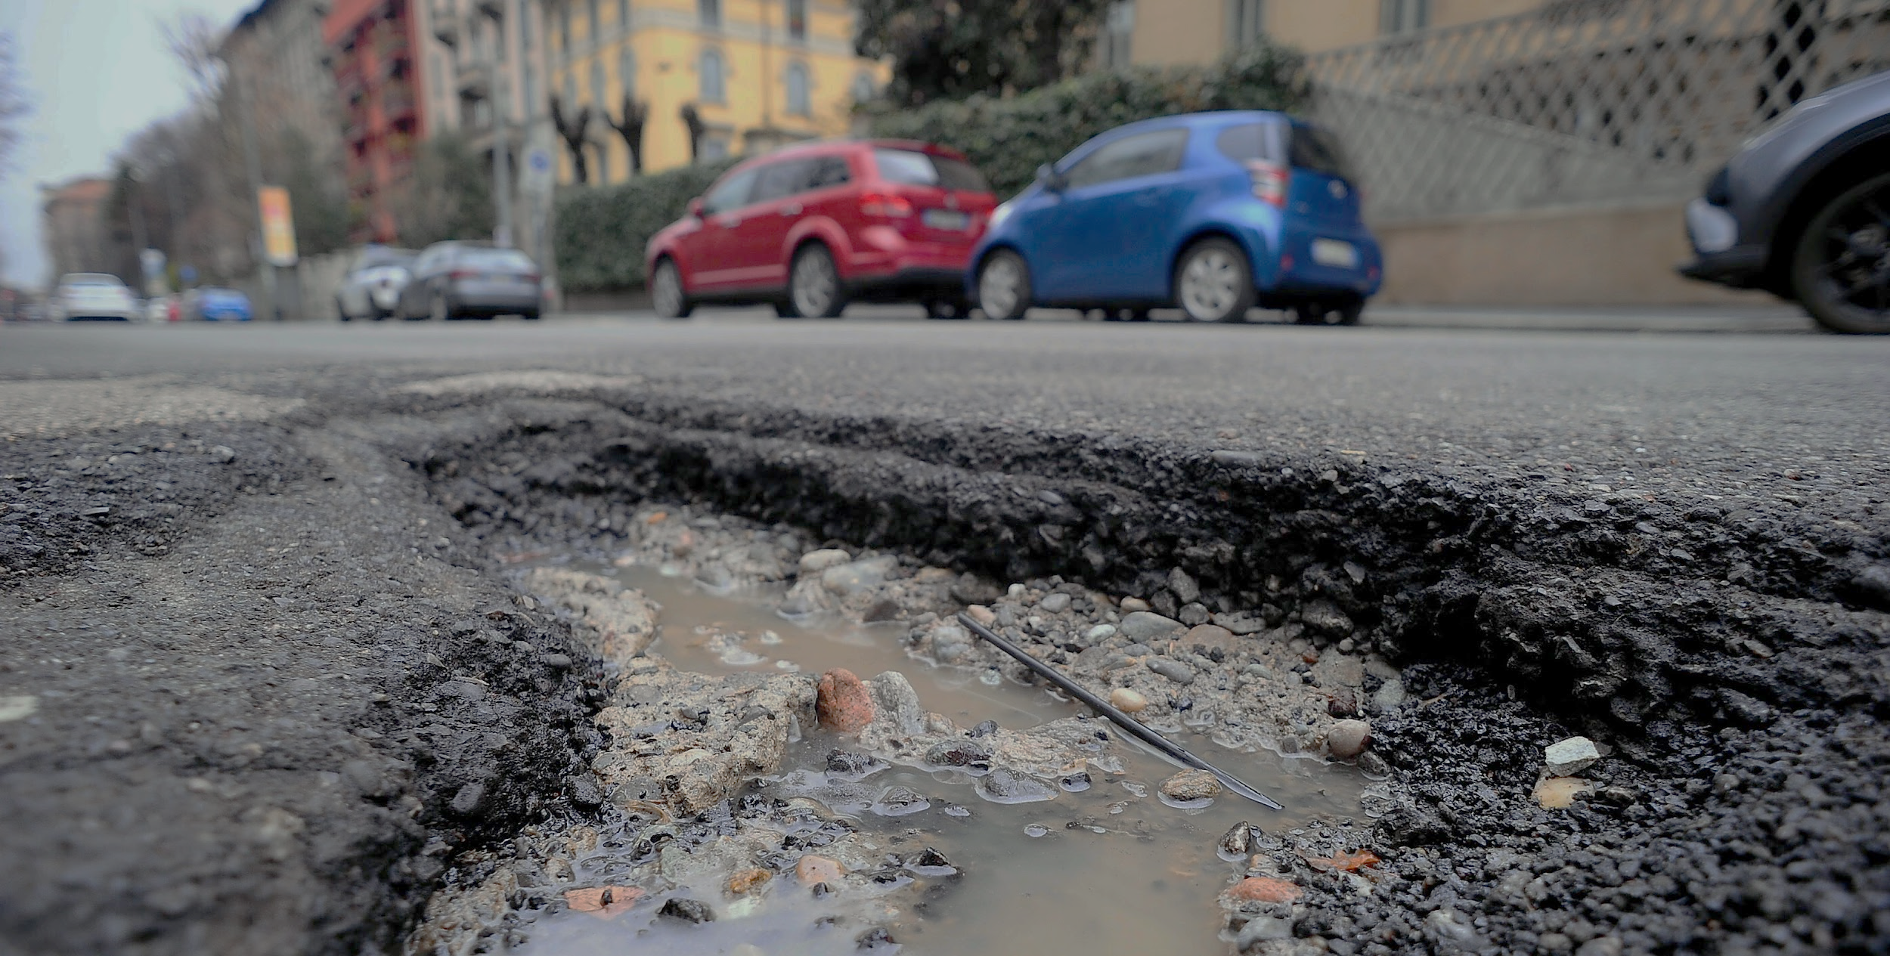
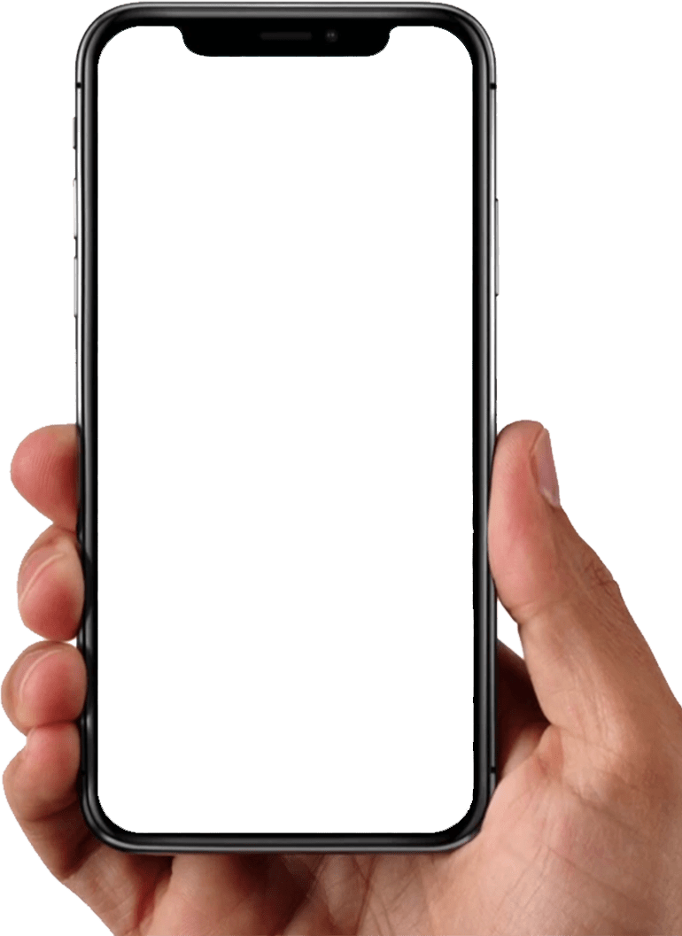
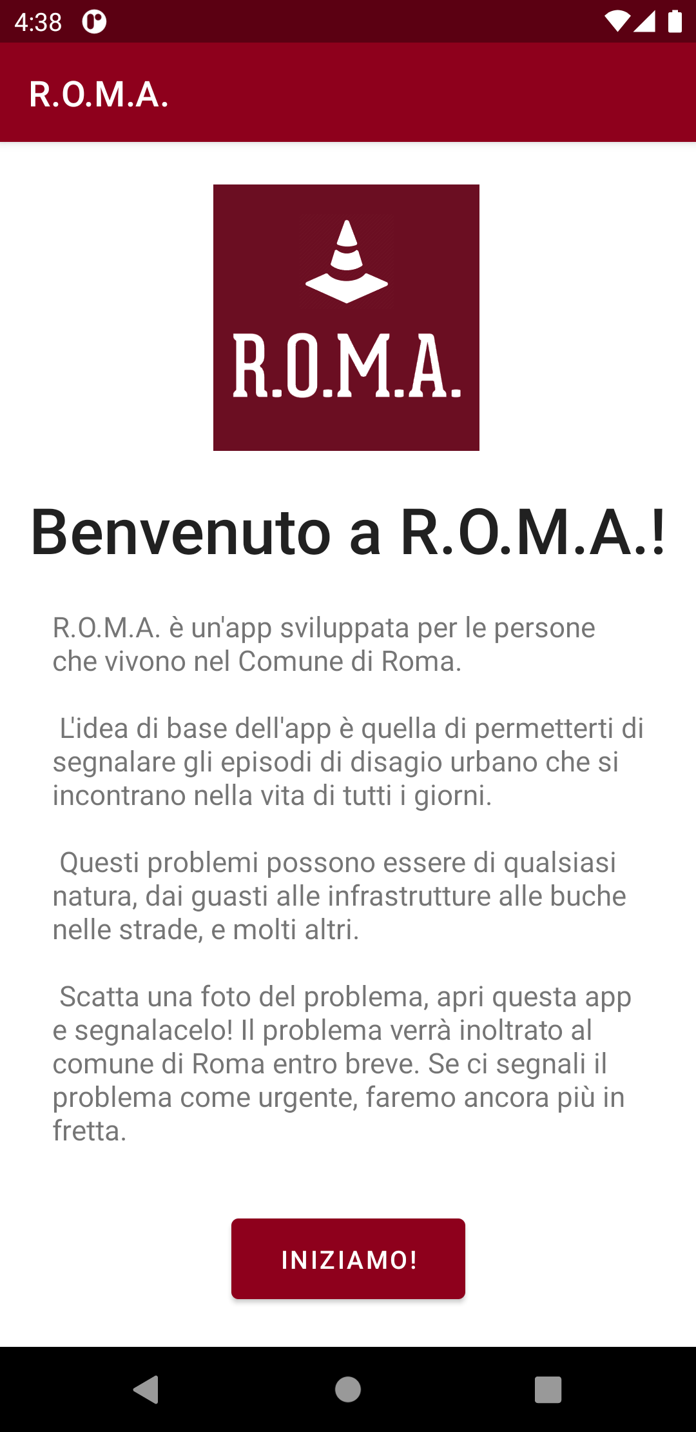
Reports Of Many Alerts
An app for reporting episodes of urban decay
Human-Computer Interaction Project
A.Y. 2020/21
Giovanni Pecorelli
Jacopo Rossi
Giacomo Venneri

Slide 2
SUMMARY
Introduction
App features
Questionnaire
User profile
User analysis – Personas and Scenarios
Competitor analysis
R.O.M.A. functionalities
First prototype
HTA - STN
Heuristic evaluation
Second prototype
Third prototype
Think aloud
Controlled experiment
ANOVA LIVE DEMO

Slide 3
Introduction
R.O.M.A. is an Android app for reporting episodes of urban decay to the competent authorities.
The development of this software is based on a User Centered Design.
The idea for this app comes from the fact that currently in Italy the procedure for reporting urban problems is quite inconvenient: after finding out which is the responsible entity (municipality, province, region, private companies…) the most used mean of communication is a registered letter with return receipt, or PEC, or a simple email.
Our idea is to simplify this process with the development of R.O.M.A., which aims to reduce waiting times and distances between citizens and competent authorities.

Slide 4
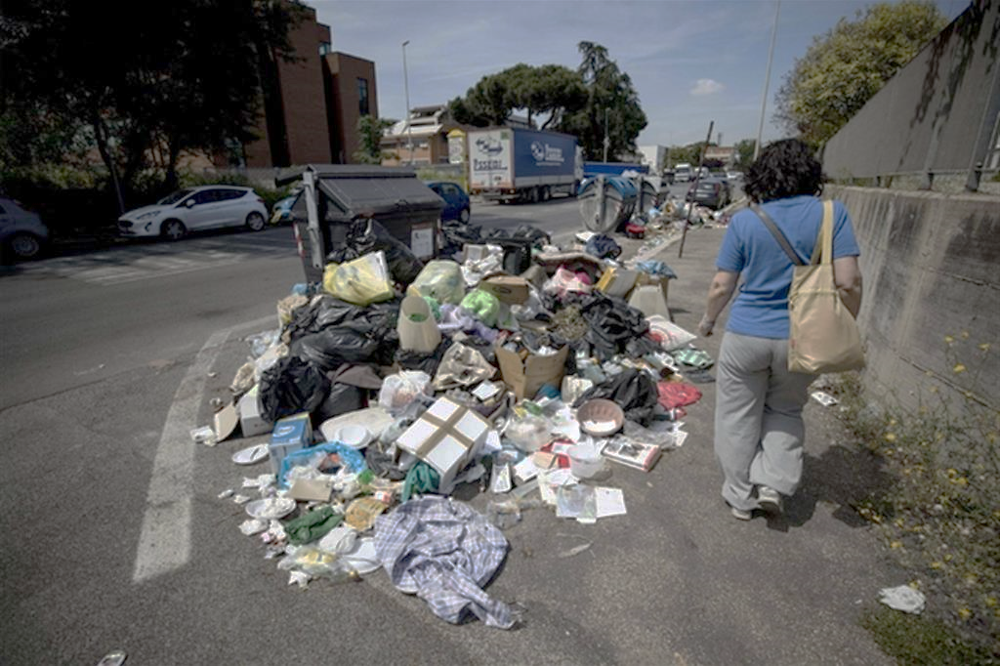
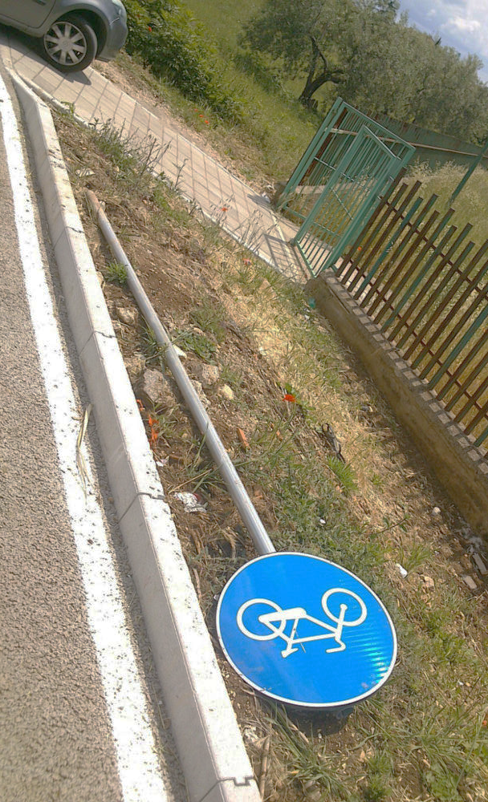
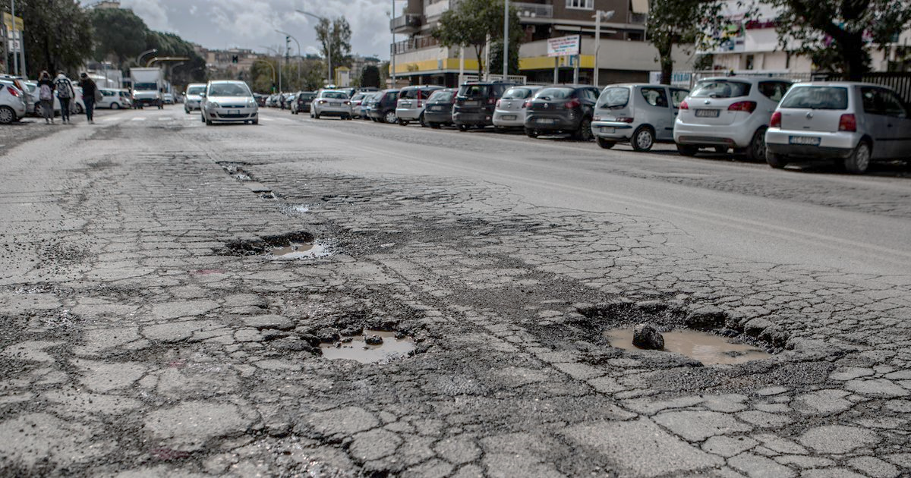
App features
R.O.M.A. is an app for improving the quality of life in the capital
01 | Register and login
02 | Report urban problems such as garbage, road
potholes, acts of vandalism and much more
03 | Monitor progress of the resolutions of your reports
04 | Explore problems shared by the community
05 | Enjoy your city!

Slide 5
Questionnaire
We created a survey in Google Modules. The questions and the answer were in Italian. Some of the questions are yes-or-no questions, while others ask for single or multiple selections.
The survey was shared in most of our University group chats and with our familiars and people close to us.
We collected 49 answers in total.

Slide 9
User profile
Age | 18-100
Gender | Any
Job Titles | Any
Education | Any
Location | The app allows reports only in the territory of the City of Rome, but the reports can be added from anywhere
Technology | Some experience with using Android apps
Passions | A desire to improve the city of Rome

Slide 10
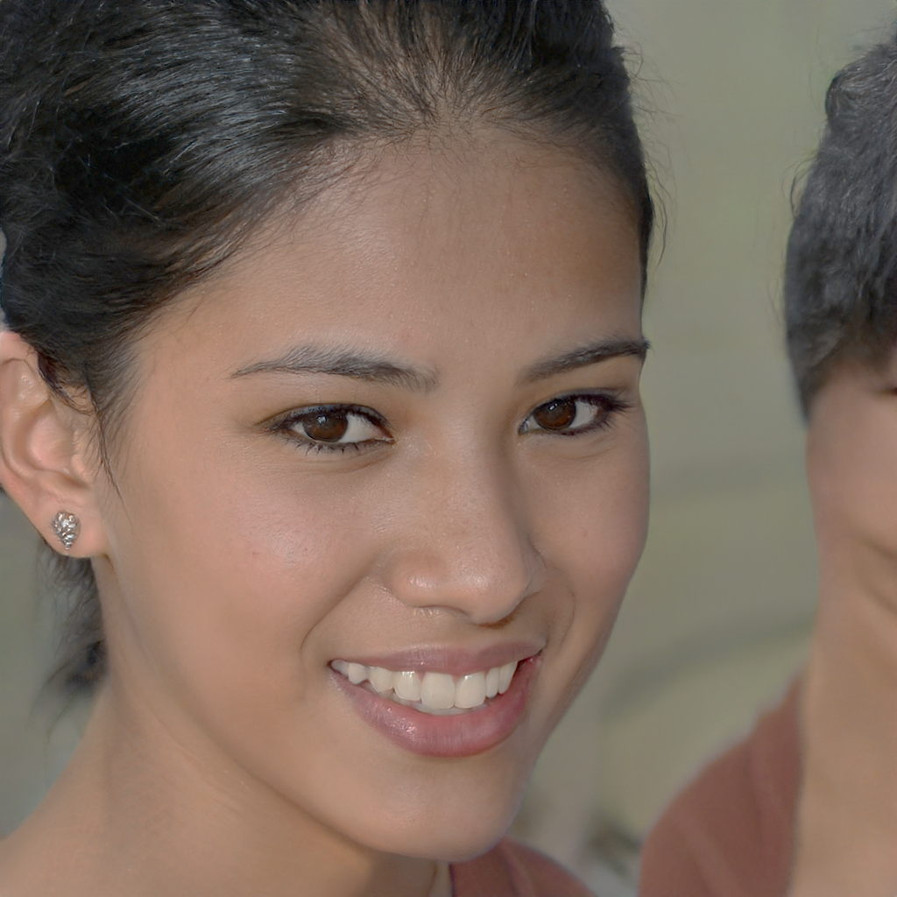
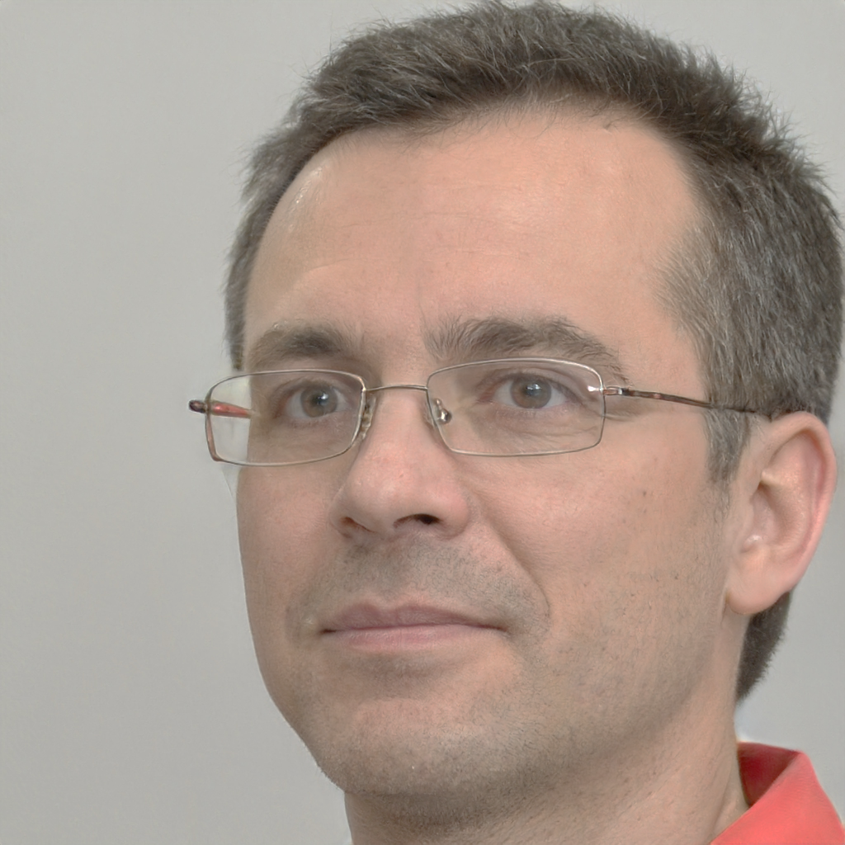
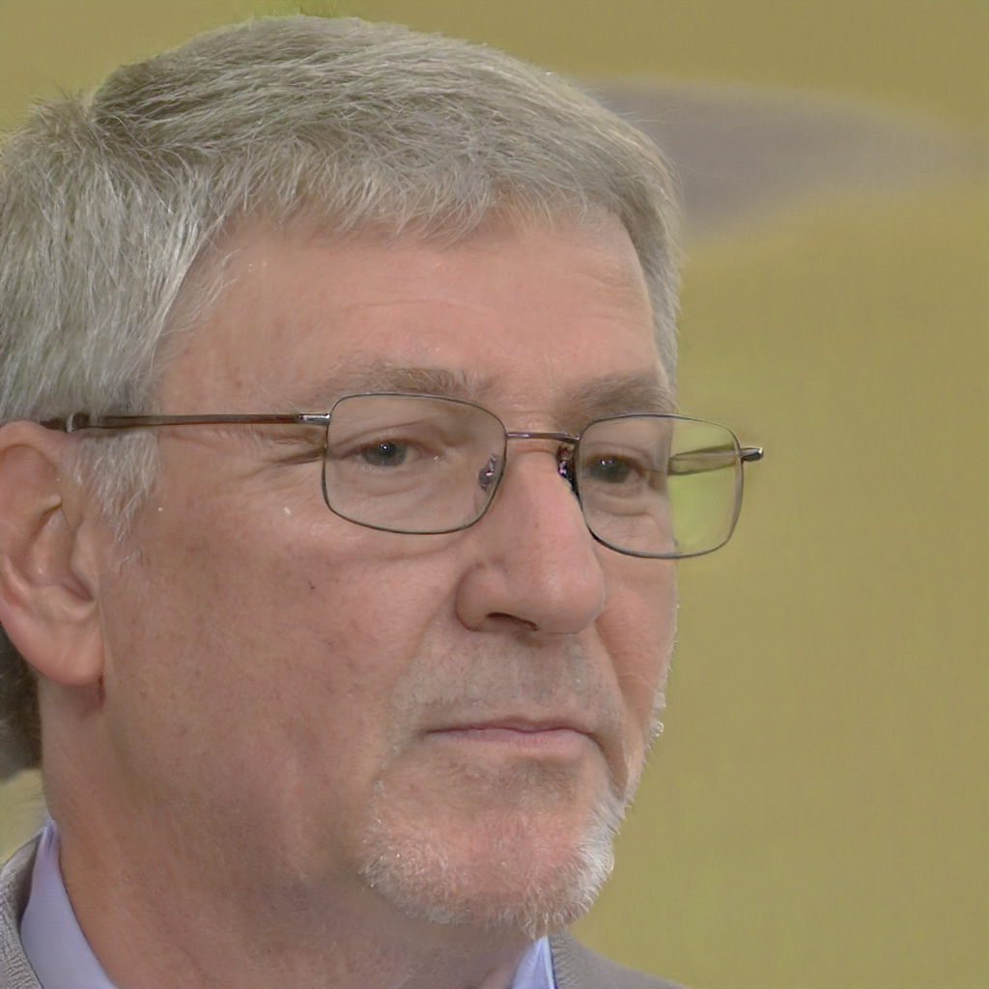
User analysis
Let’s introduce a selection of possible users of R.O.M.A.
In the next slides we will examine more closely their personas and when they would use R.O.M.A. in a real-life scenario.
Caterina
Gabriele
Franco
Age: 23
Gender: Female
Job title: Medical student
Location: Piazza Bologna
Family: Single
Income: 0€\year
Age: 45
Gender: Male
Job title: Civil engineer
Location: Parioli
Family: Married w/children
Income: 40000€\year
Age: 71
Gender: Male
Job title: Retired
Location: Ostia
Family: Married
Income: 12000€\year

Slide 11
Caterina
Persona
Caterina is a medical student in Sapienza. She is currently at the fourth year, and wants to specialize in dentistry in the future. She transferred from her hometown in Tuscany and rented
a student home in San Lorenzo, near a metro station that takes her the University campus.
She doesn’t have a job yet so she tries to keep her expenses low, taking public transportation
or walking when she can. She usually uses a mobile 4G internet connection to browse internet
and use social apps on her phone.
Scenario
Caterina takes the metro to her University every morning. One day, she is late for the first lesson of the morning. Unfortunately she can’t exit quickly from the metro station because
there is a crowd on the stairs on the way out. The reason for this is that the escalators are broken, once again.
Caterina, disappointed by this setback, decides to take action and searches for a way to report
this problem. She then finds out about R.O.M.A.

Slide 12
Gabriele
Persona
Gabriele is a civil engineer. He is happily married, has two lovely children, but the true passion of his life are cars. He changes them frequently to experience new feelings on the road. He is always up to date with computer and smartphone technologies.
Scenario
After a hard day of work Gabriele, tired, is ready to go home. Today he didn’t park his car in the company parking, but in another farther spot. When he gets to his car, he finds an unpleasant surprise on his windscreen: a fine. Apparently he parked in an unsignaled no
parking area. The reason for this mistake was that the road sign forbidding the parking was almost entirely covered by the vegetation.
Irritated, he reports the problem to R.O.M.A.

Slide 13
Franco
Persona
Franco is retired. He has lived in Ostia all his life. He loves the city and know all of its places. Even if he is not very interested in technology, he has a smartphone and he is able to use all its basic functionalities (downloading and using simple app). Anyway, he has a niece who helps him when he has problems with it.
Scenario
Every day during the last months, Franco is annoyed by the presence of a deep pothole right in front of his garage. Each time he wants to get in or out of it, he has to maneuver to avoid it. One day, his niece comes to visit him, and hearing his complaints about the pothole, she helps him reporting this problem with R.O.M.A.

Slide 14
Competitor analysis
In the past years there has been some attempts to create similar applications.
After a research on the Play Store, we found some possible competitors of R.O.M.A.:
• WeDU! Decoro Urbano
• Bucapp
• ROMA Al tuo Fianco
• +Firenze
Here we briefly analyze each of them, listing their features and their limits.

Slide 15




WeDU! Decoro Urbano
Pros:
Free
Login with Facebook
App and website
GPS
Cons:
Not functioning since 2019
Few categories
No urgent reports
Bucapp
Pros:
Free
More than one photo per report
Cons:
Only about potholes
No GPS
ROMA Al tuo Fianco
Pros:
Free
Official
GPS
Cons:
No user profiles
No details or description about reports
Only 4 categories
+Firenze
Pros:
Free
GPS
Cons:
No user profiles
Reports are not public

Slide 16
R.O.M.A. functionalities
R.O.M.A. will offers the functionalities of registration and login, with email and password or with Google and Facebook.
After the login, the user can see all of the reports made in the area of Rome by the other users. They are represented as colored markers on a map. There is a GPS button to quickly find your position. Furthermore, the map in the homepage is also the place where new reports are created.
The reports can be explored visually on the map in the homepage or browsed in the Explore page, where they are shown with full details.
If the user is interested in seeing all of the reports made by a single user, he has the possibility to view their profile, where he can found information about the user and a list of all the reports he made.
Of course, a user can also access and see his own profile. Here the Setting page can be found. He can manage his profile by changing his username or deleting reports.

Slide 17
First prototype
Our first prototype was realized through mock-up made in Balsamiq, a free program that allows to quickly build low-fidelity user interfaces.
We designed it using standard Google material and Android components, such as the bottom navigation bar and the expandable cards to contain the reports information.
Prototype functionalities:
Register and login with email, username and password
View reports of other users in the Map and in the Explore sections
View Your Profile page and your reports history
View other users’ Profile pages, and the reports they made
Add a new report

Slide 18
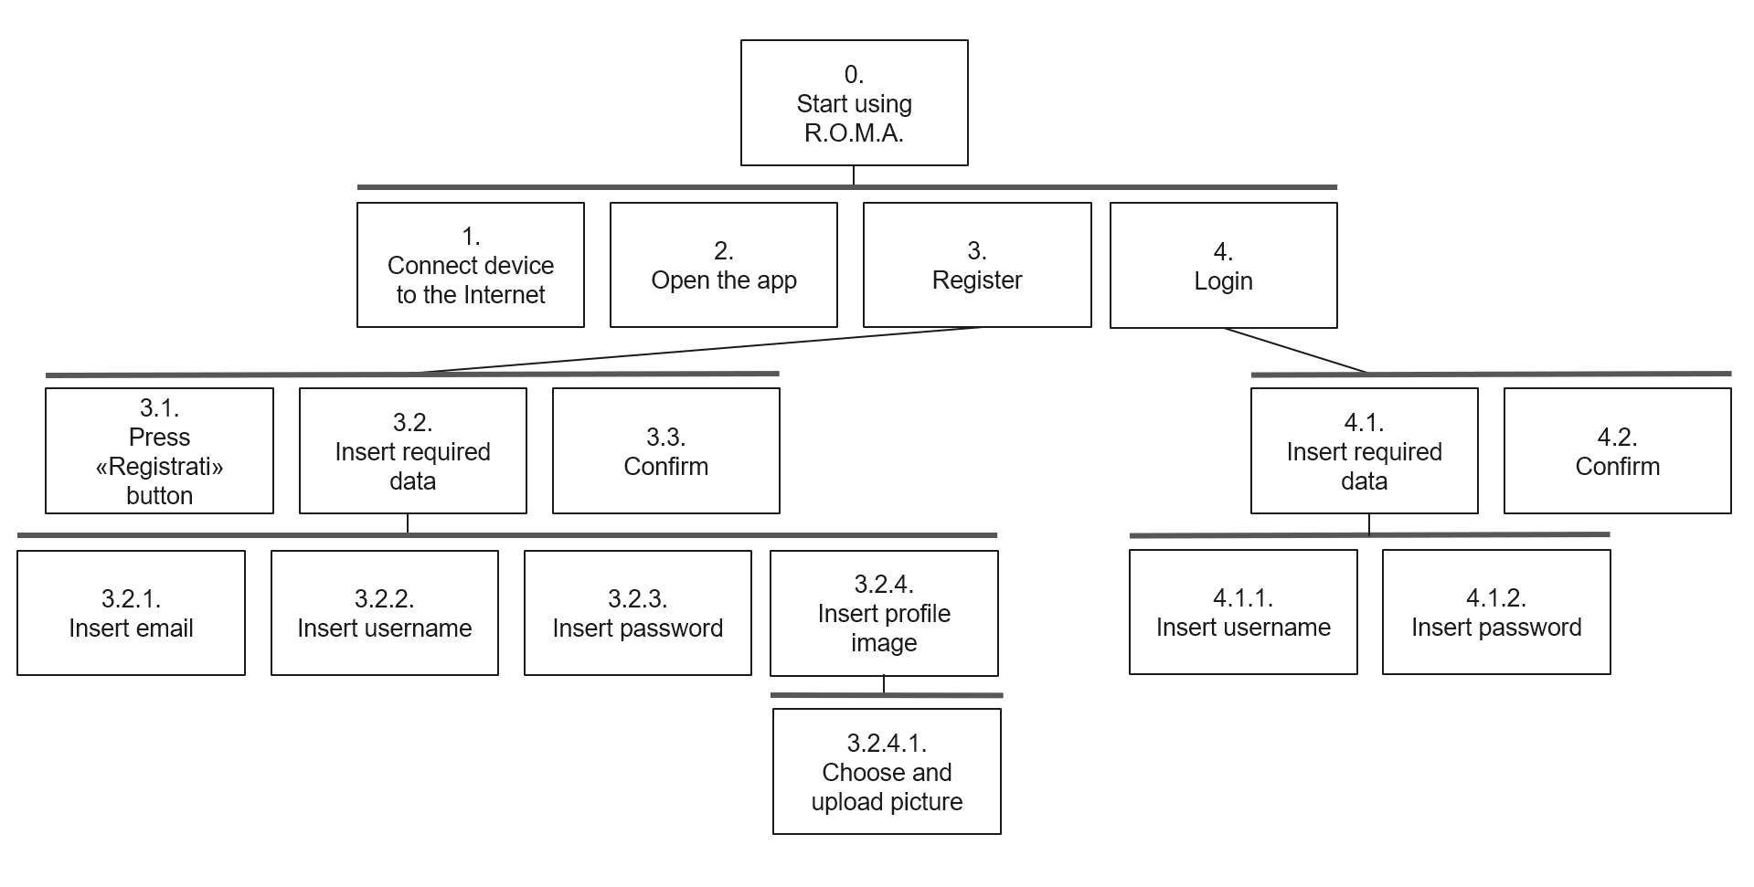
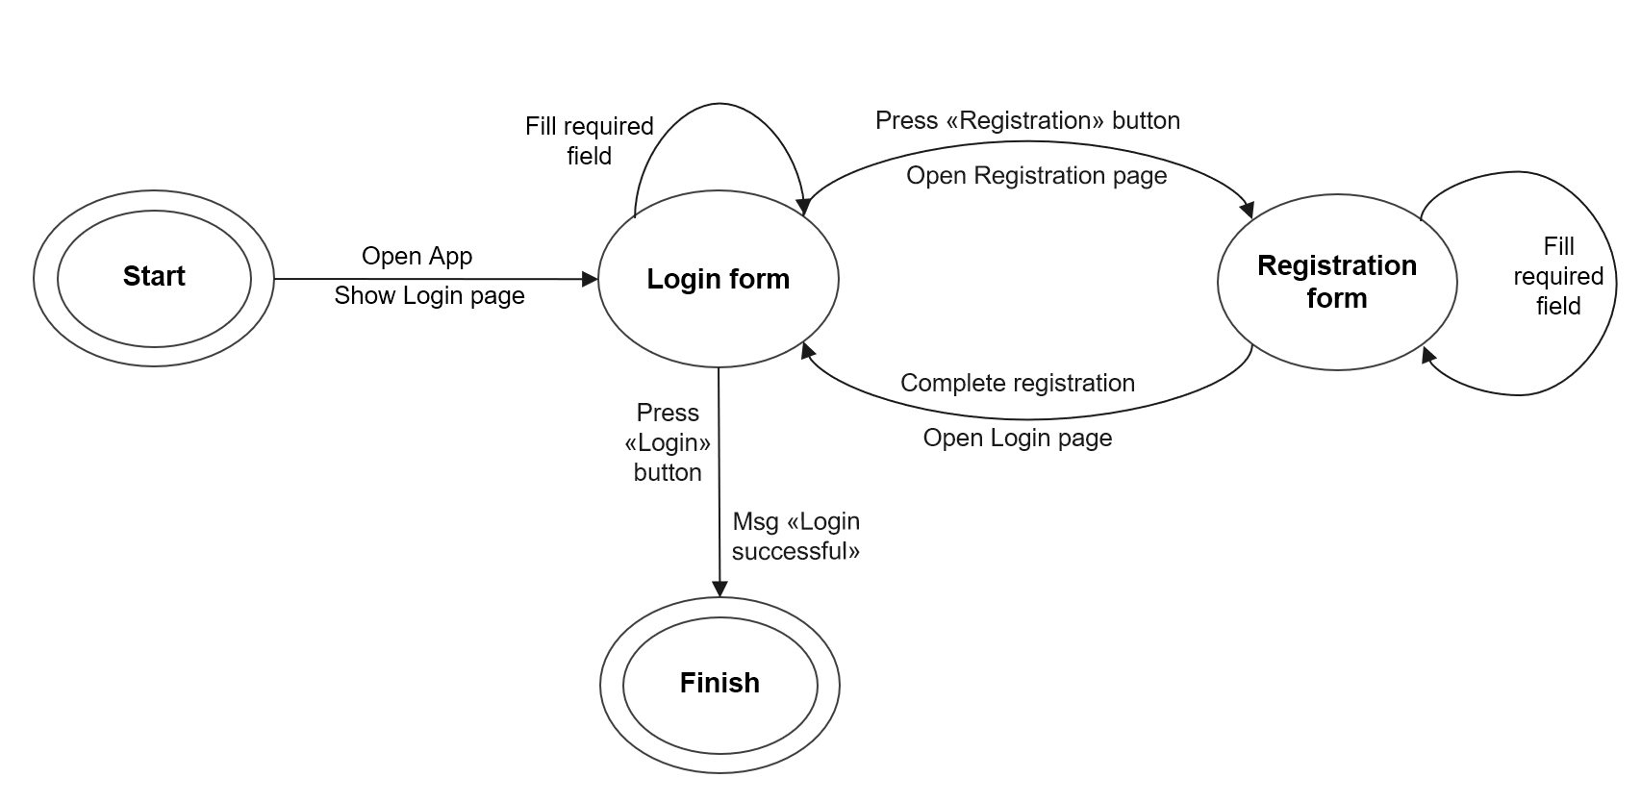
Start using R.O.M.A.
HTA
STN

Slide 19
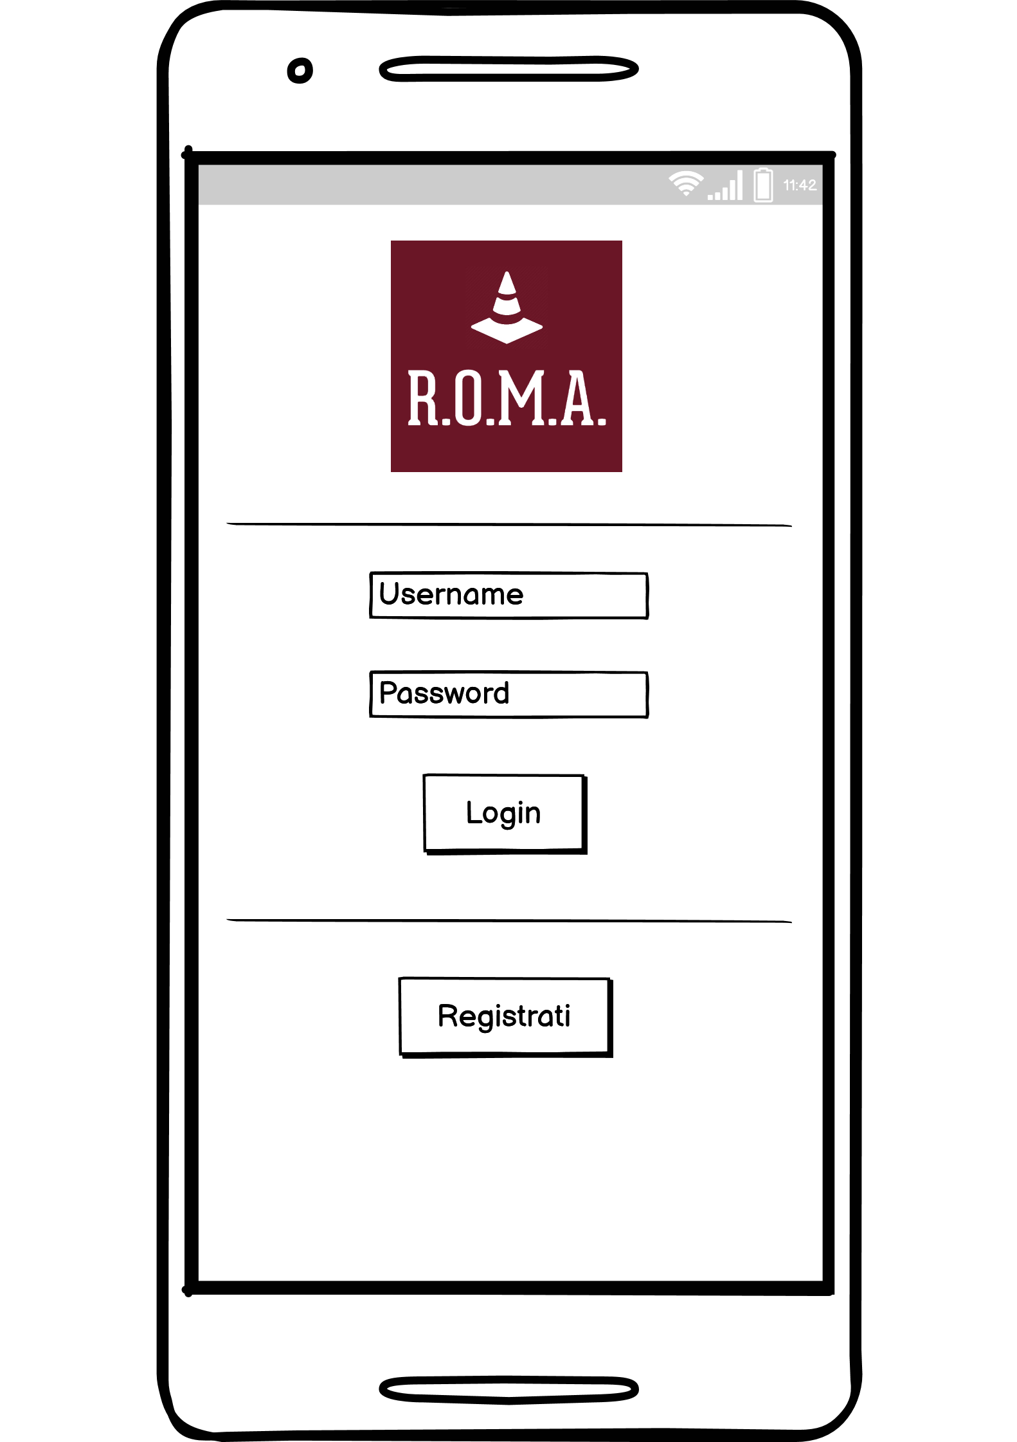
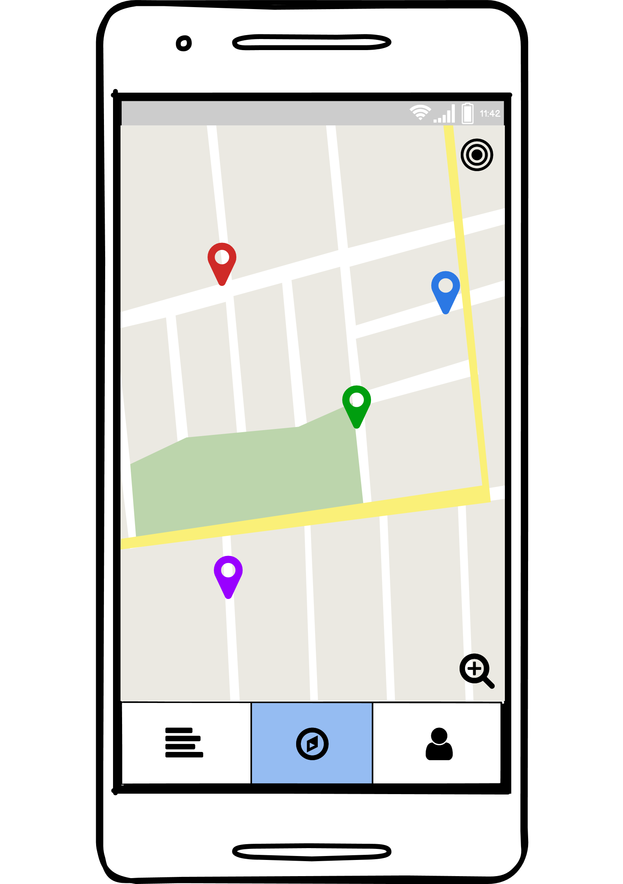
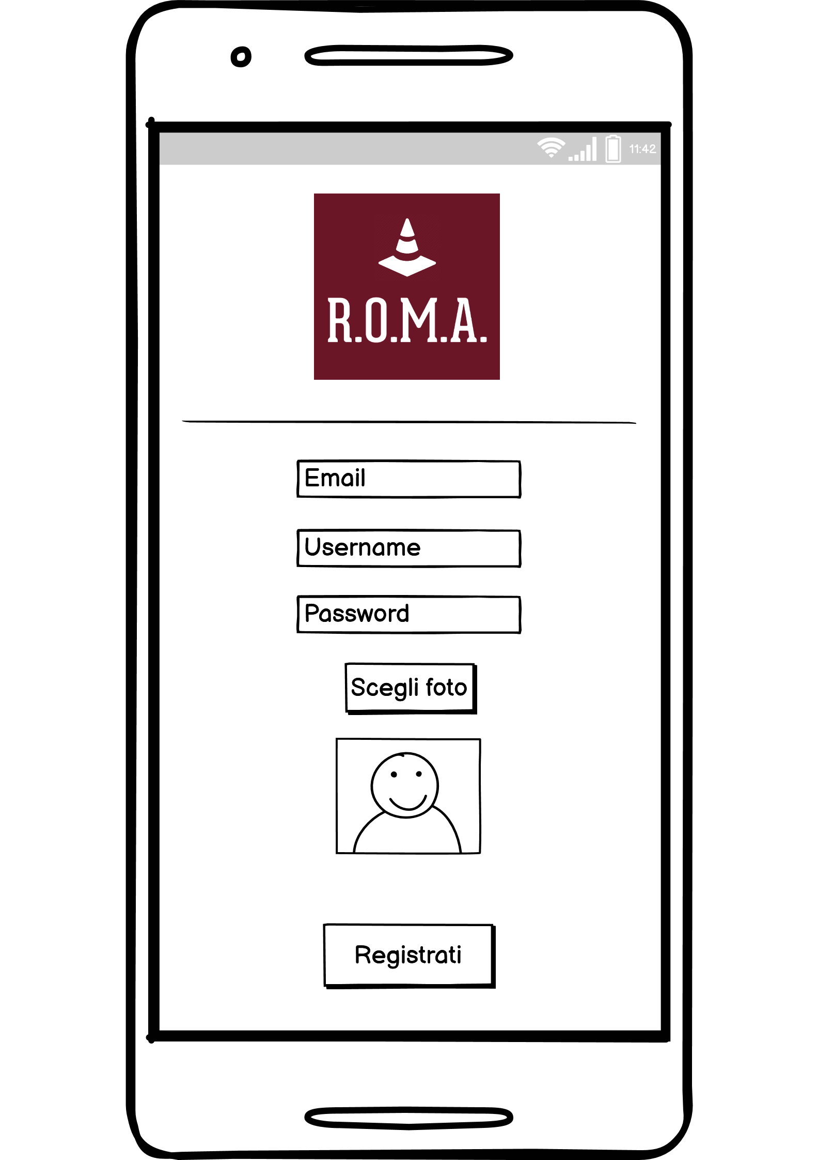
Start using R.O.M.A.

Slide 20
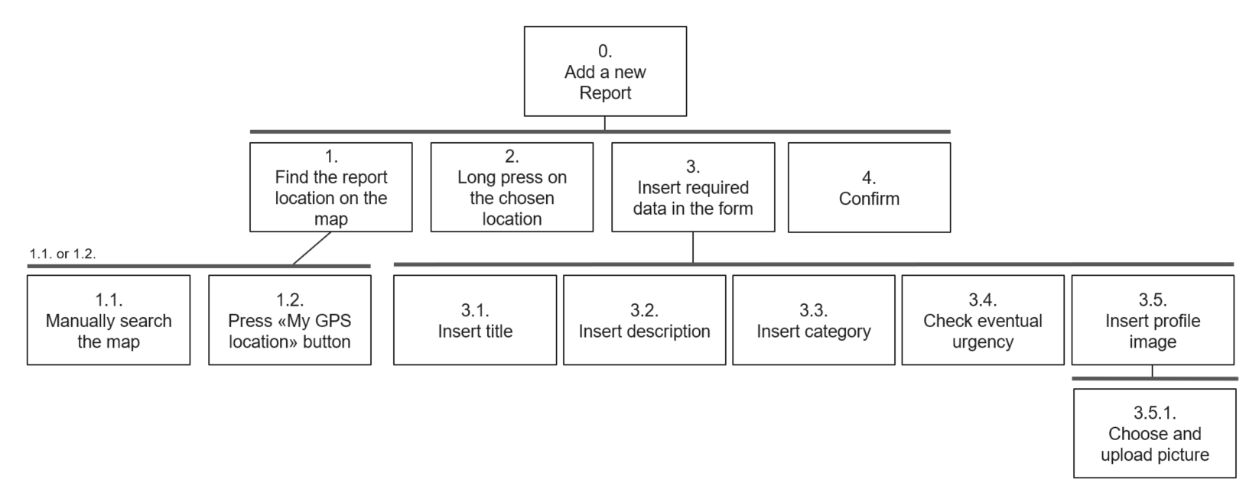
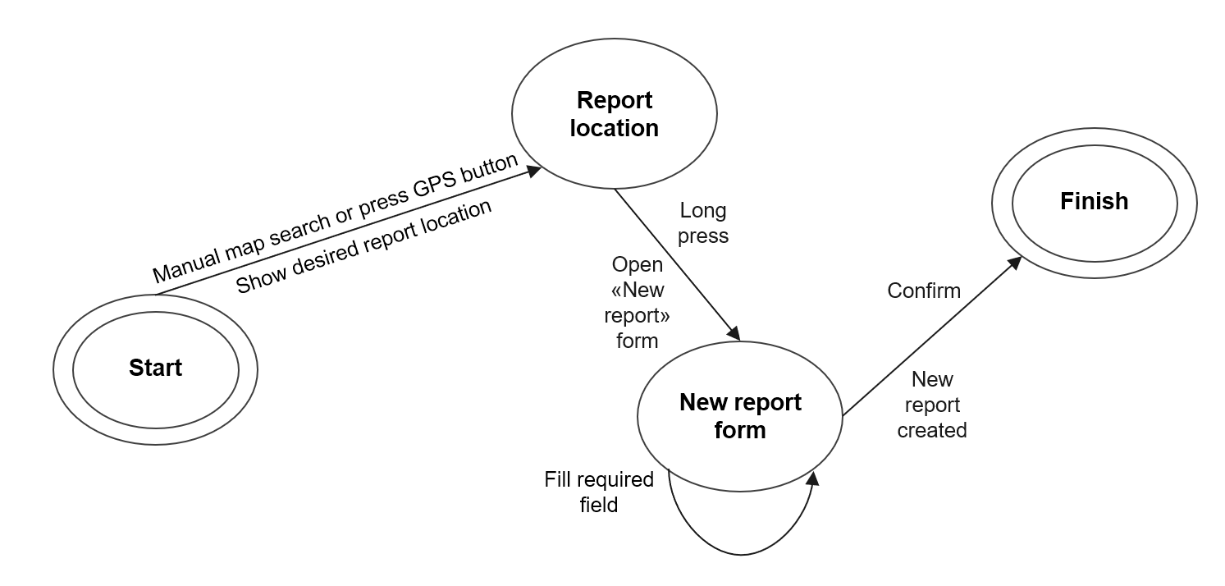
Add a new report
HTA
STN

Slide 21
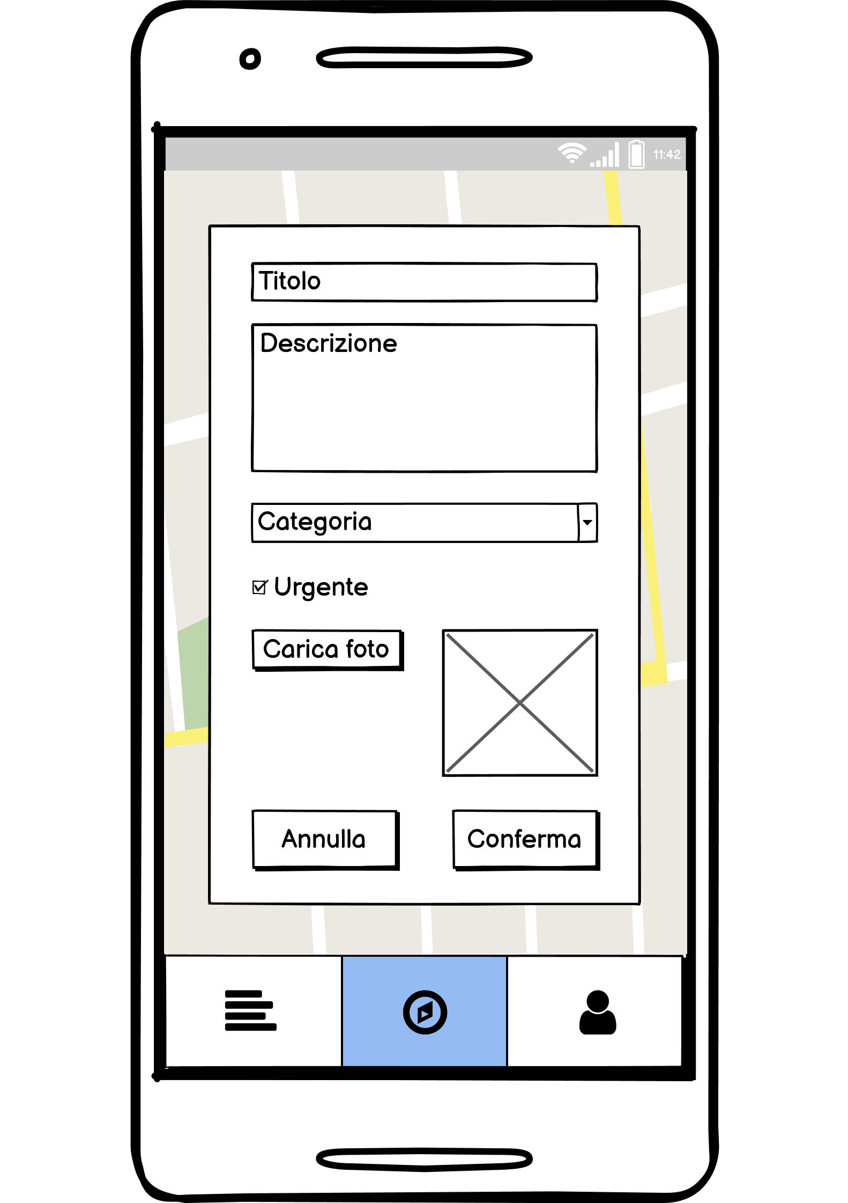
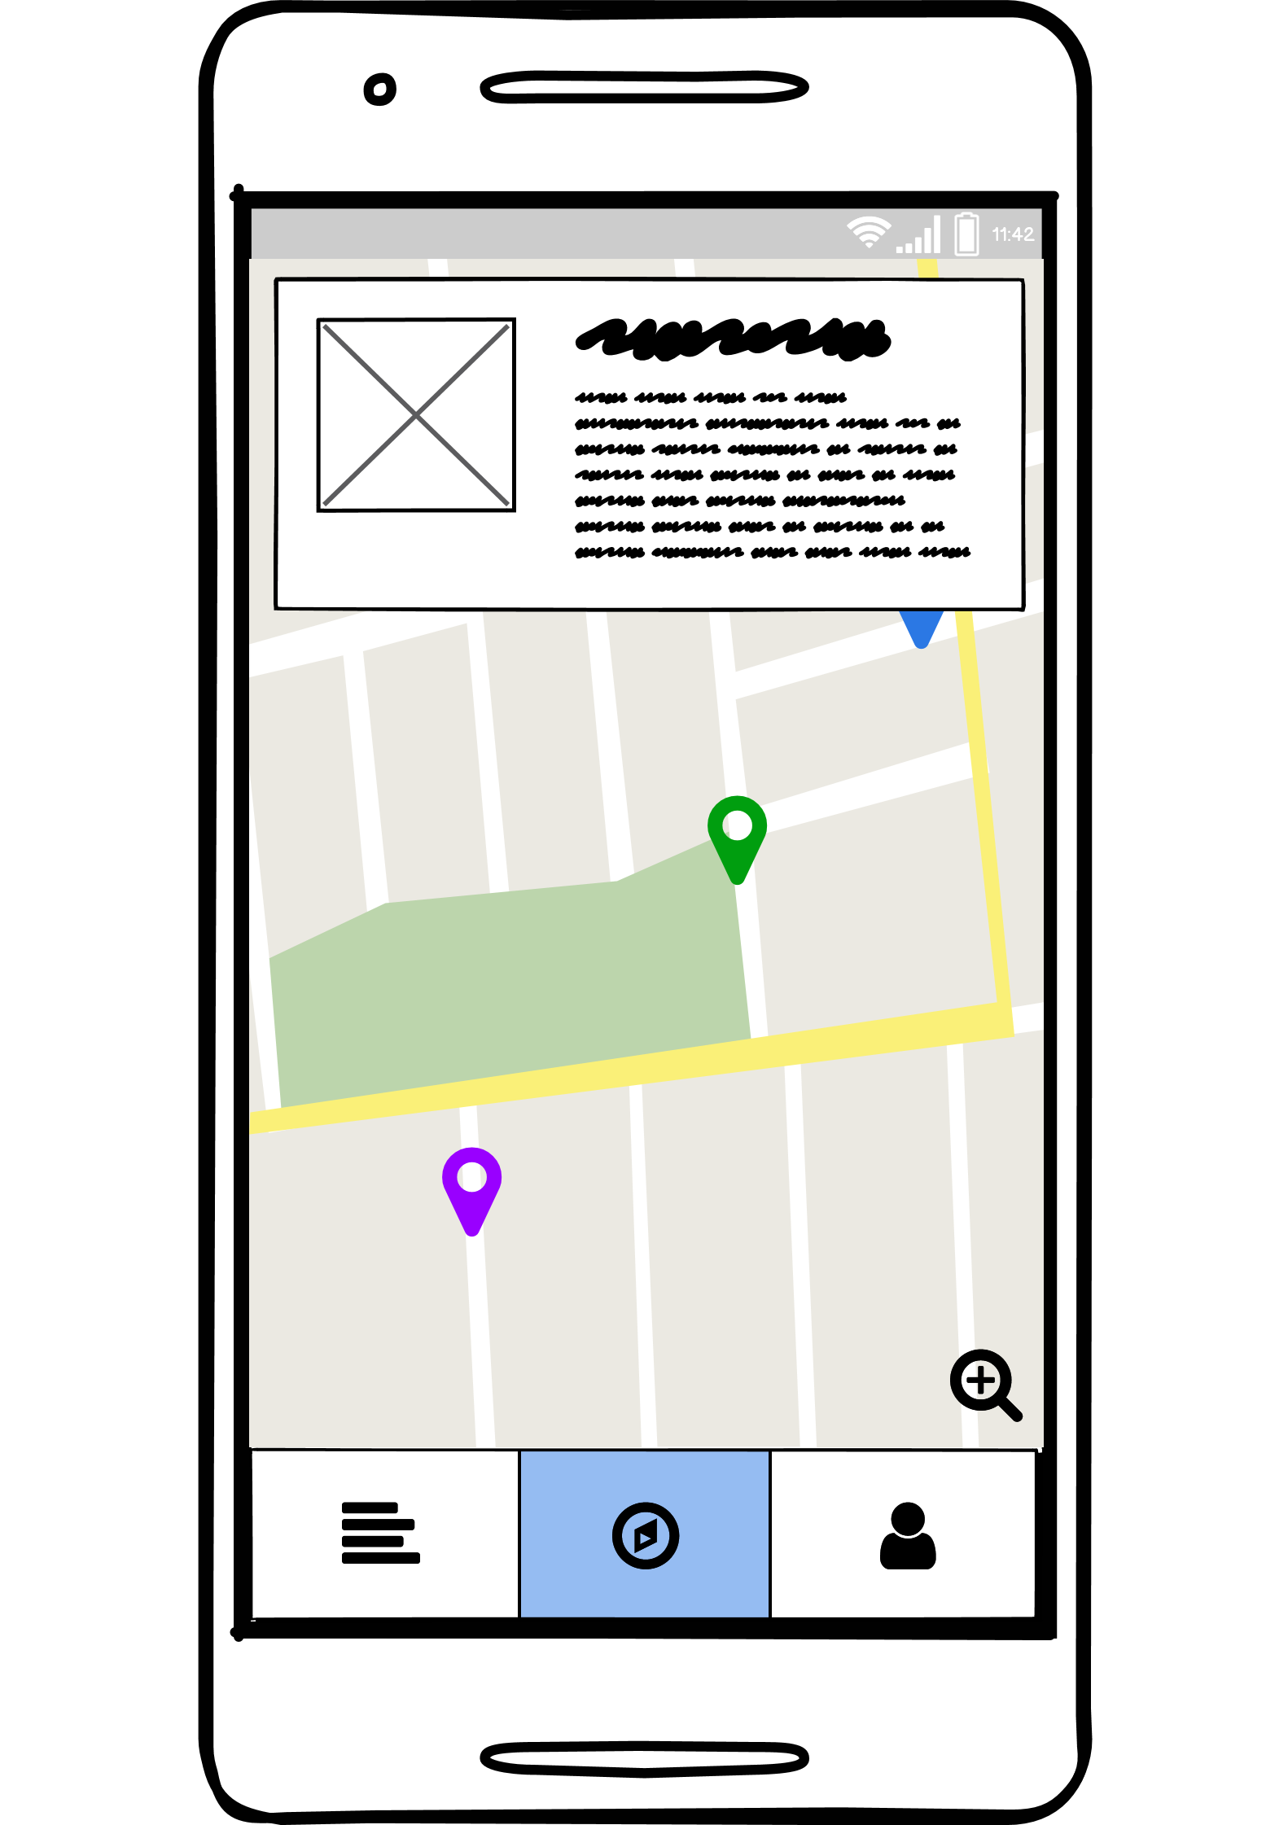
Add a new report

Slide 22
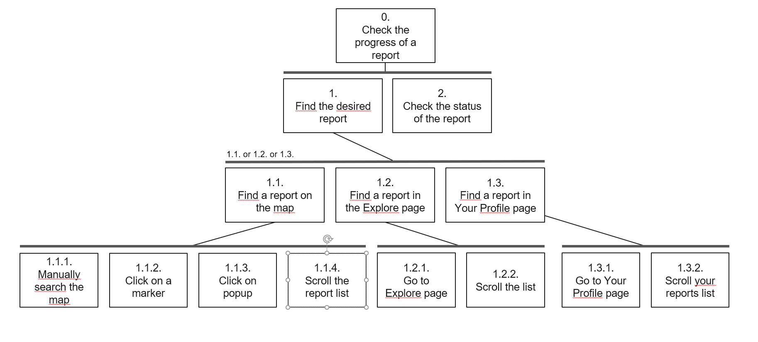
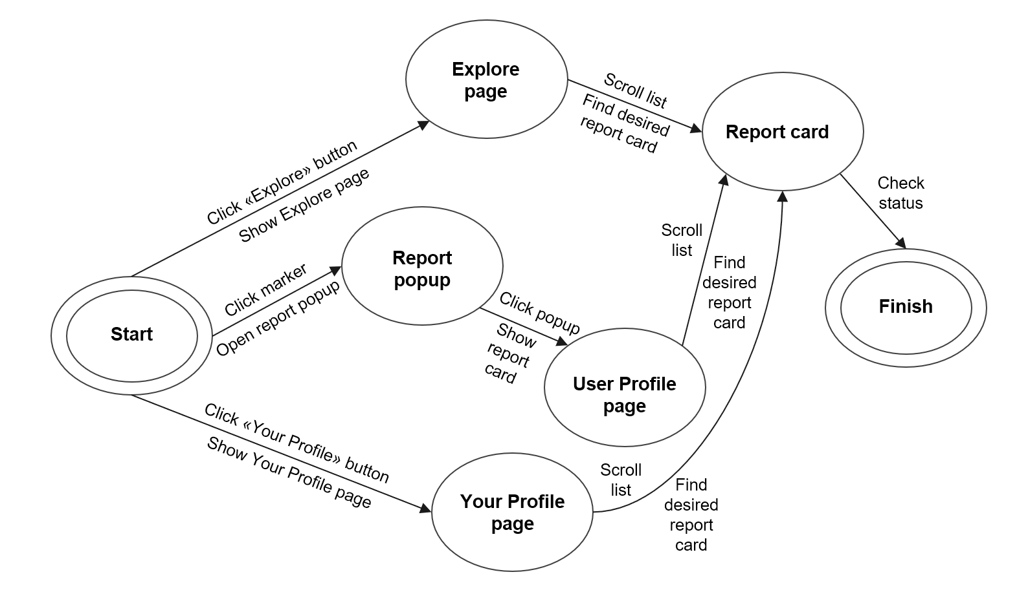
Check the progress of a report
HTA
STN

Slide 23
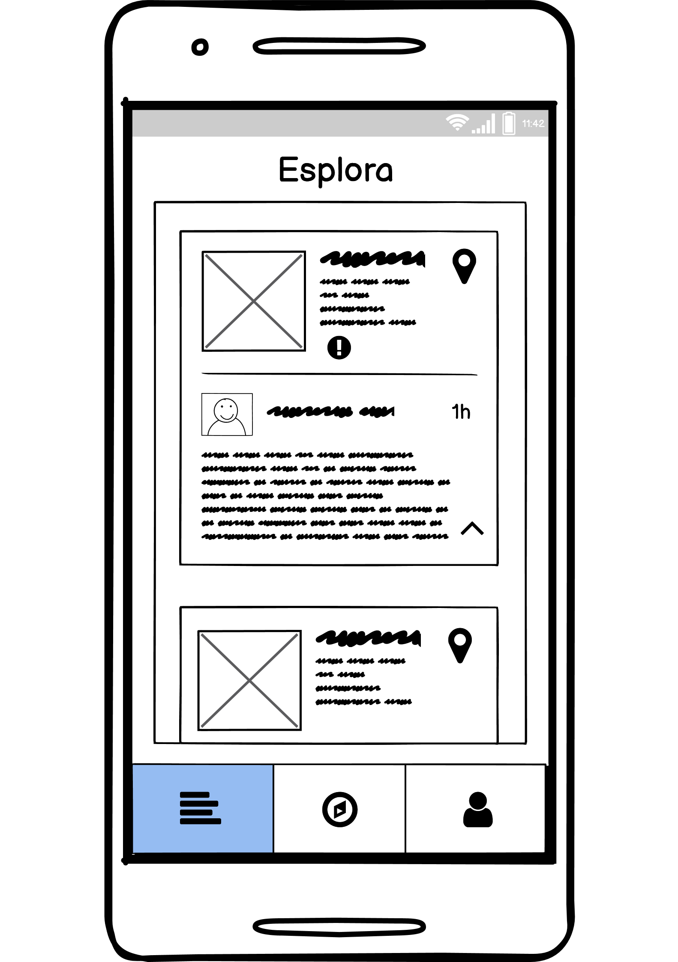
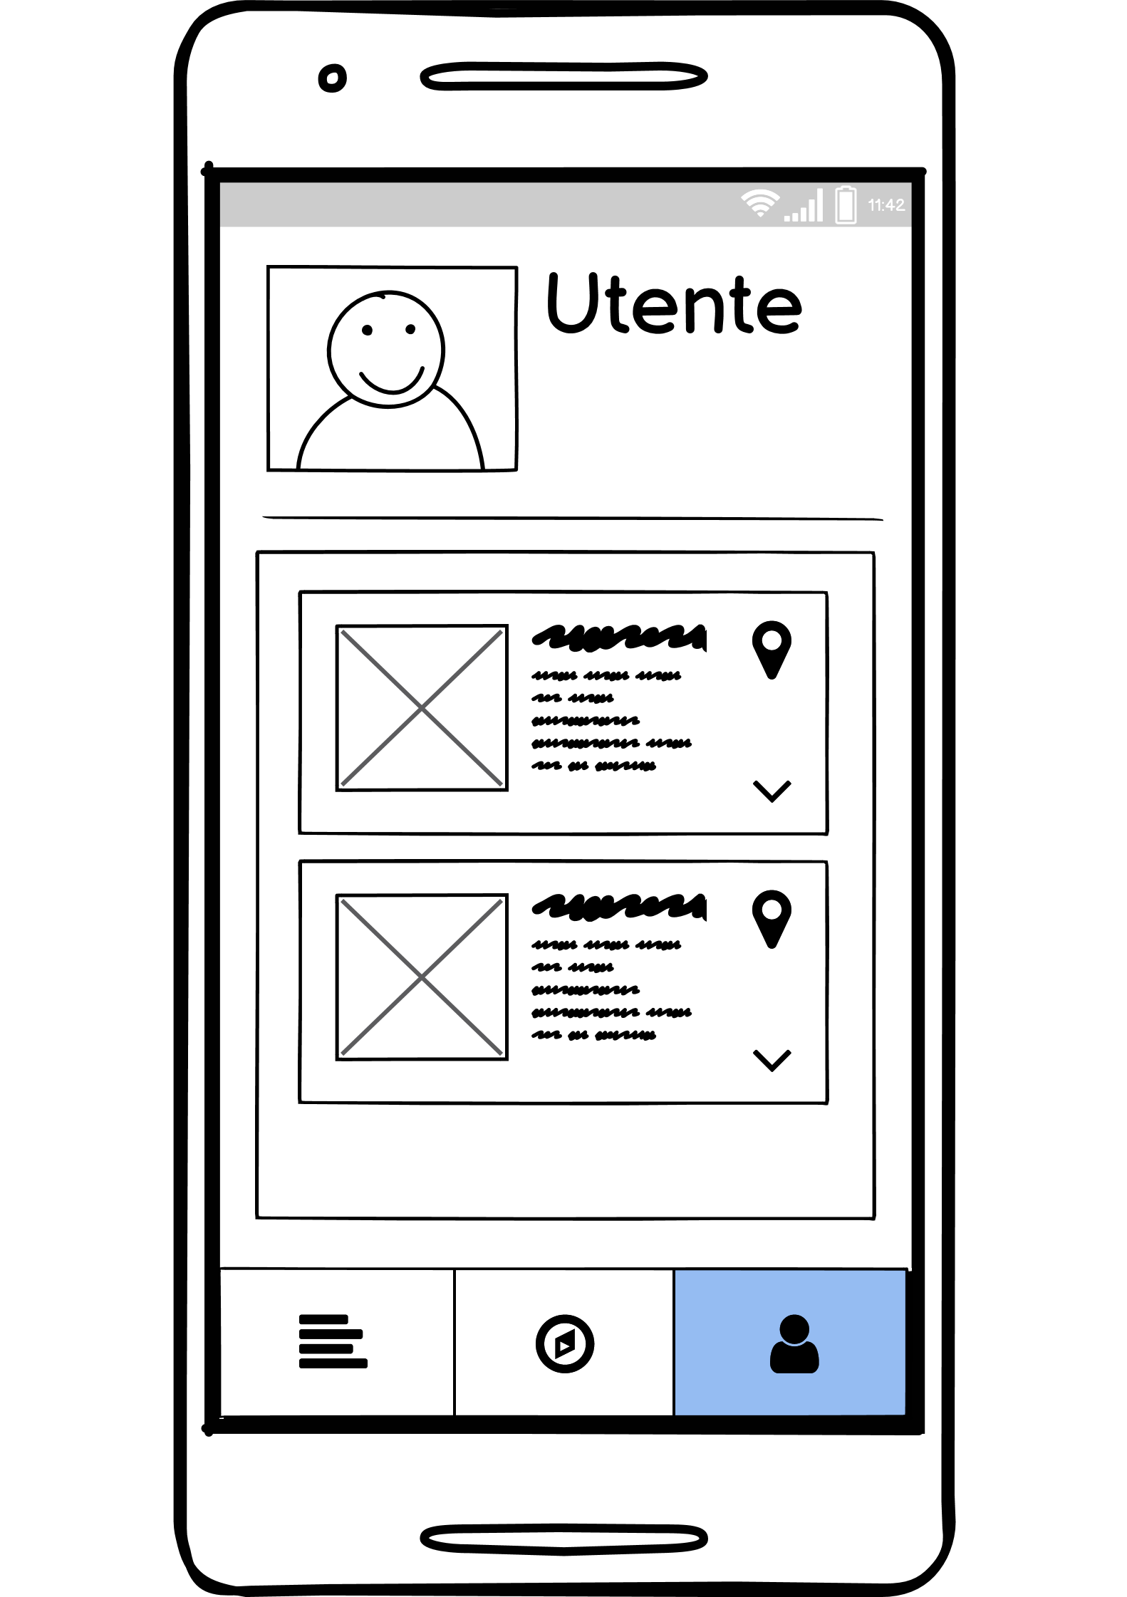
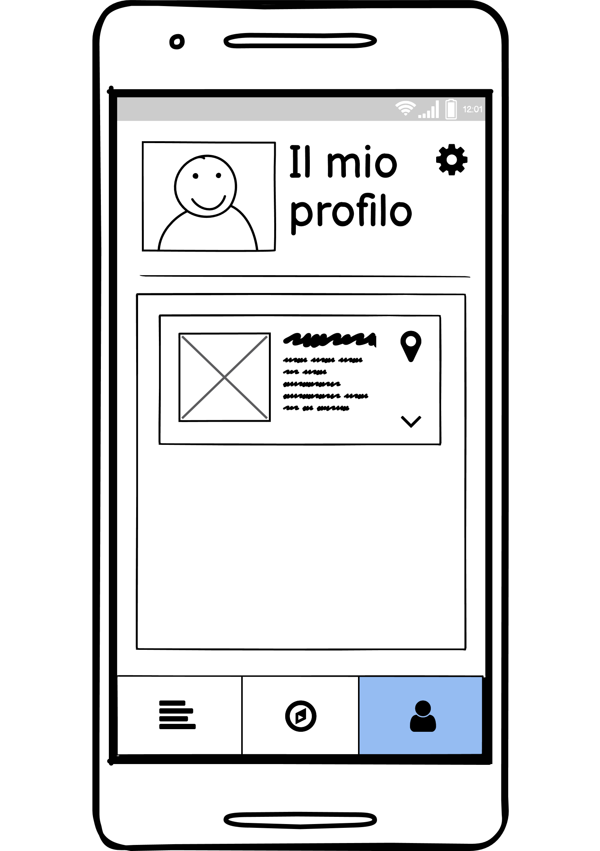
Check the progress of a report

Slide 24
Heuristic evaluation
A heuristic evaluation is a usability inspection methodology for computer software that helps to debug design, highlighting the problems we should solve to achieve better results in the user interface. It is one of the most popular informal methods of usability inspection in the field of human computer interaction.
The list of criteria, that is adopted, is well defined and standardized.

Slide 25
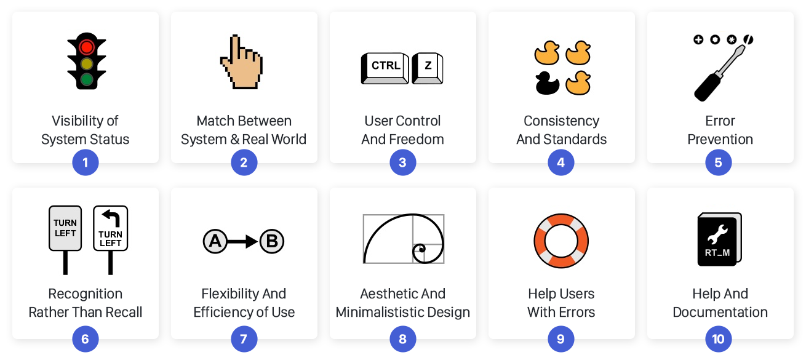
Nielsen’s heuristics for usability

Slide 26
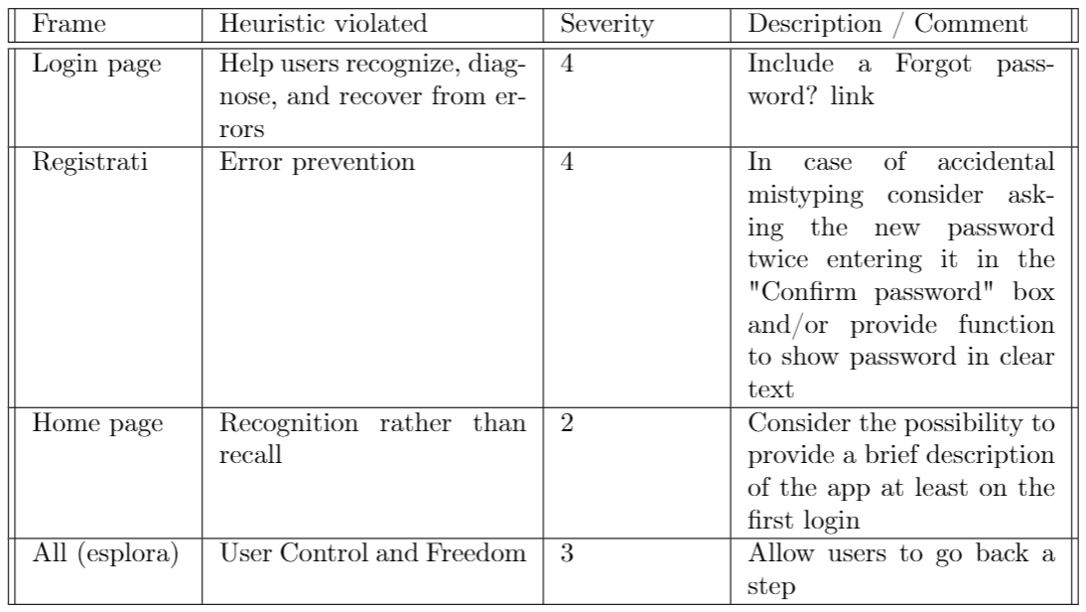
Heuristics evaluation of our project
Expert evaluation was made by Valeria Mirabella.

Slide 27
Second prototype
The second prototype is realized using Android Studio.
In the following slides we describe the changes we adopted to solve the heuristics problems

Slide 28

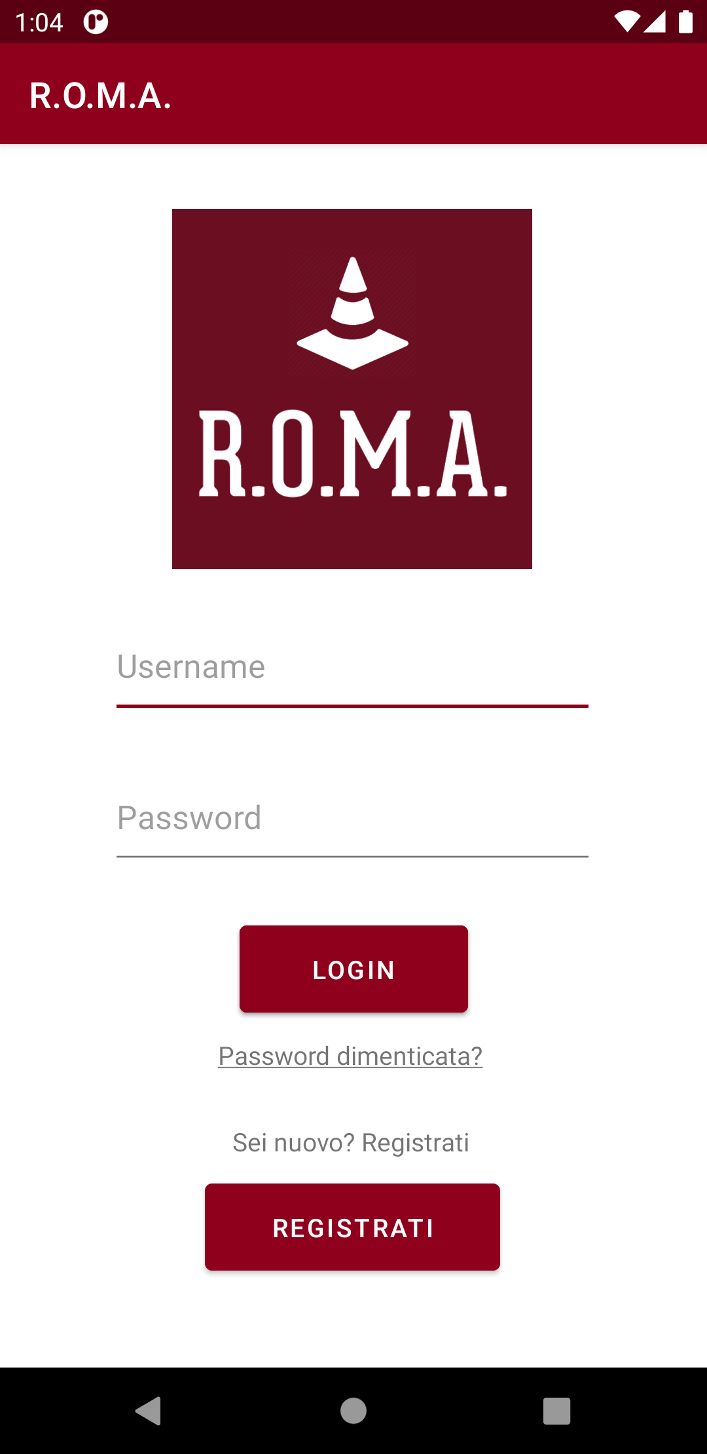
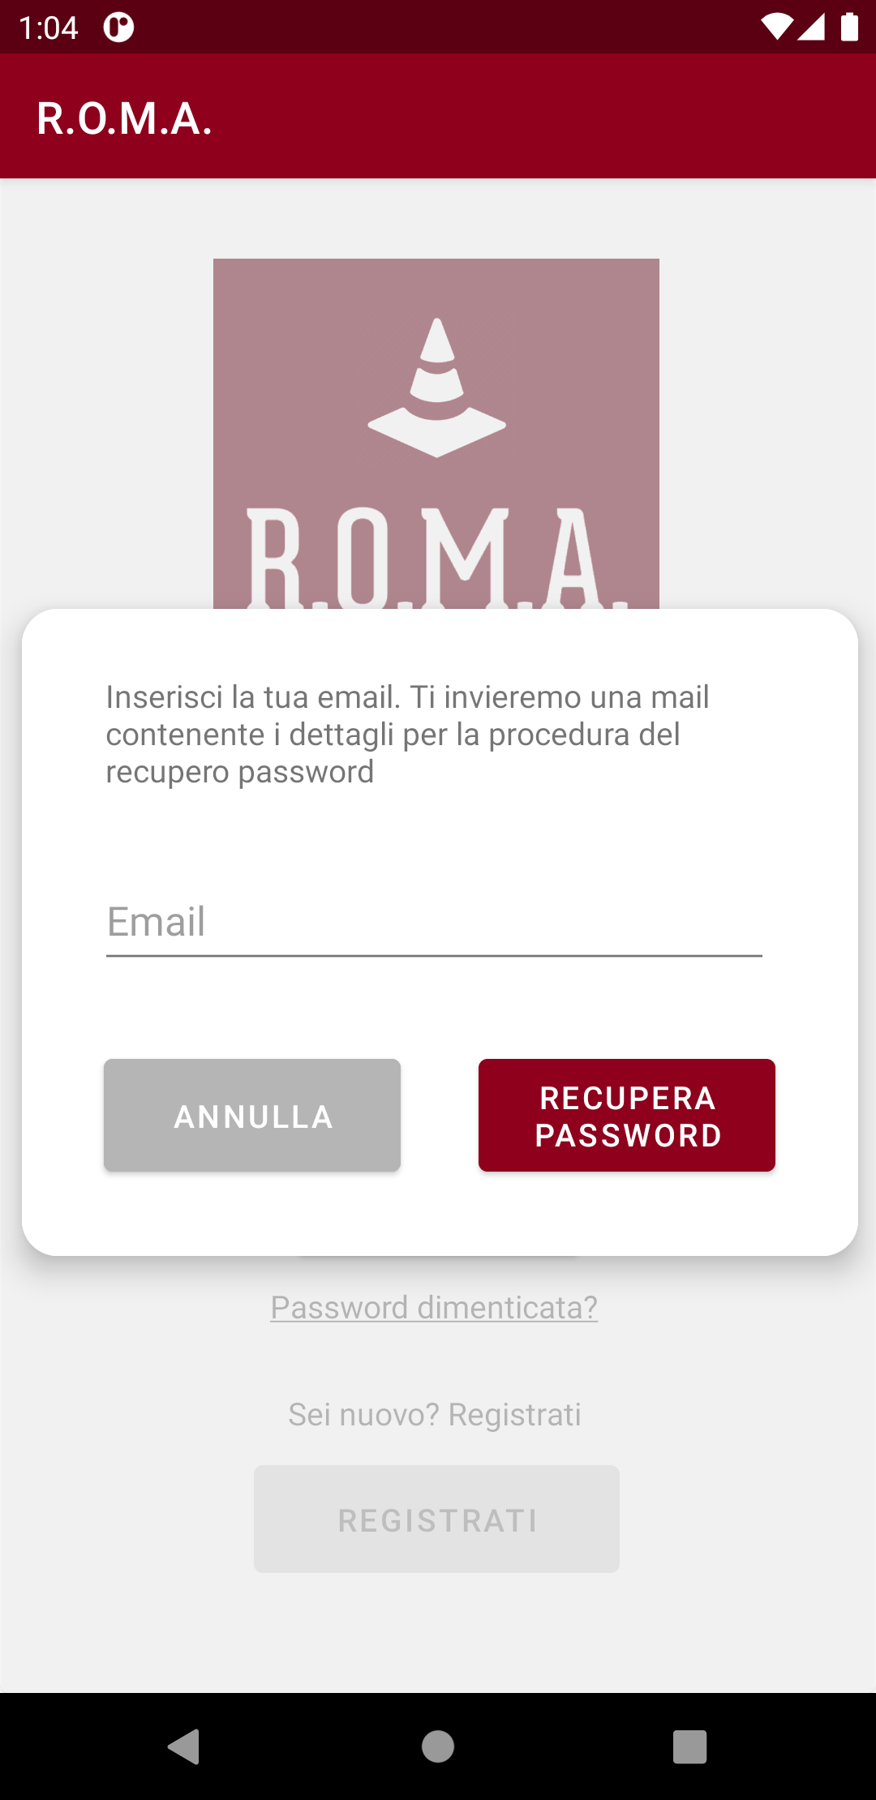
We add a "Forgotten password?" link to initiate the procedure for obtaining a new password.
Login page in the first prototype with Balsamiq, with violated heuristic
Login page in Android corrected with the "Password dimenticata" link and relative popup

Slide 29

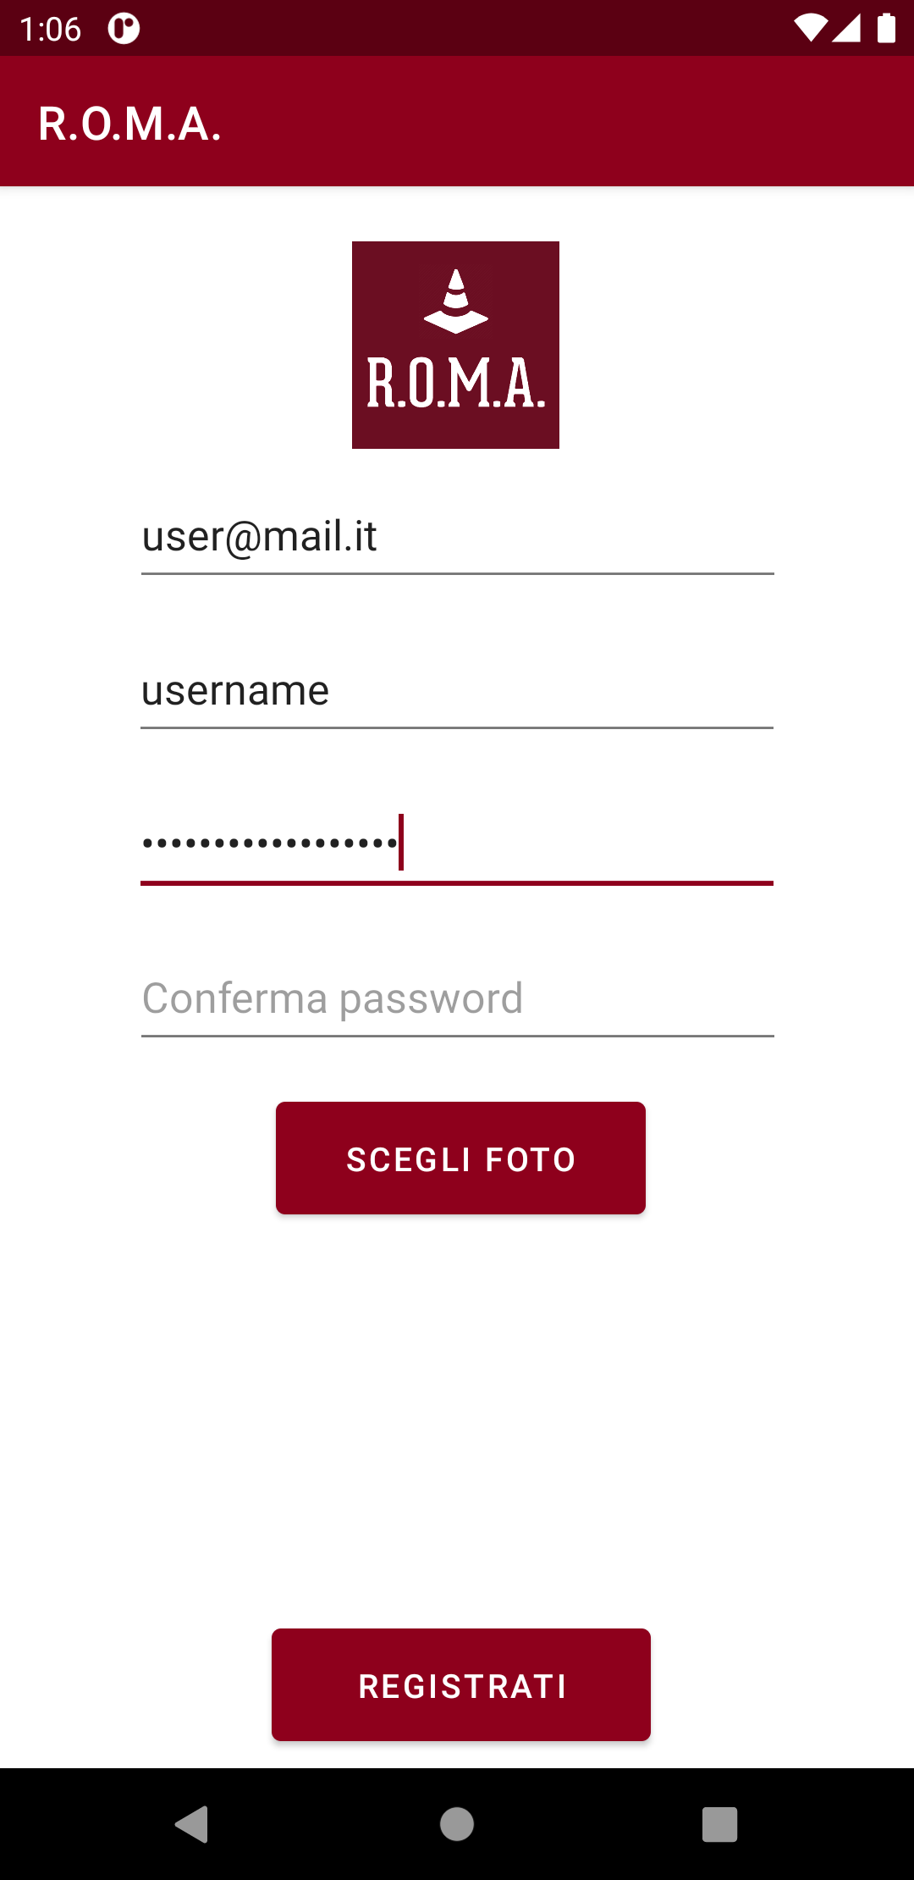
We decide to ask the user to input his password twice. In this way the user has a way of knowing that he entered the password he intended to.
Registration page: before and after

Slide 30

We add an Info page into the app
Info page

Slide 31
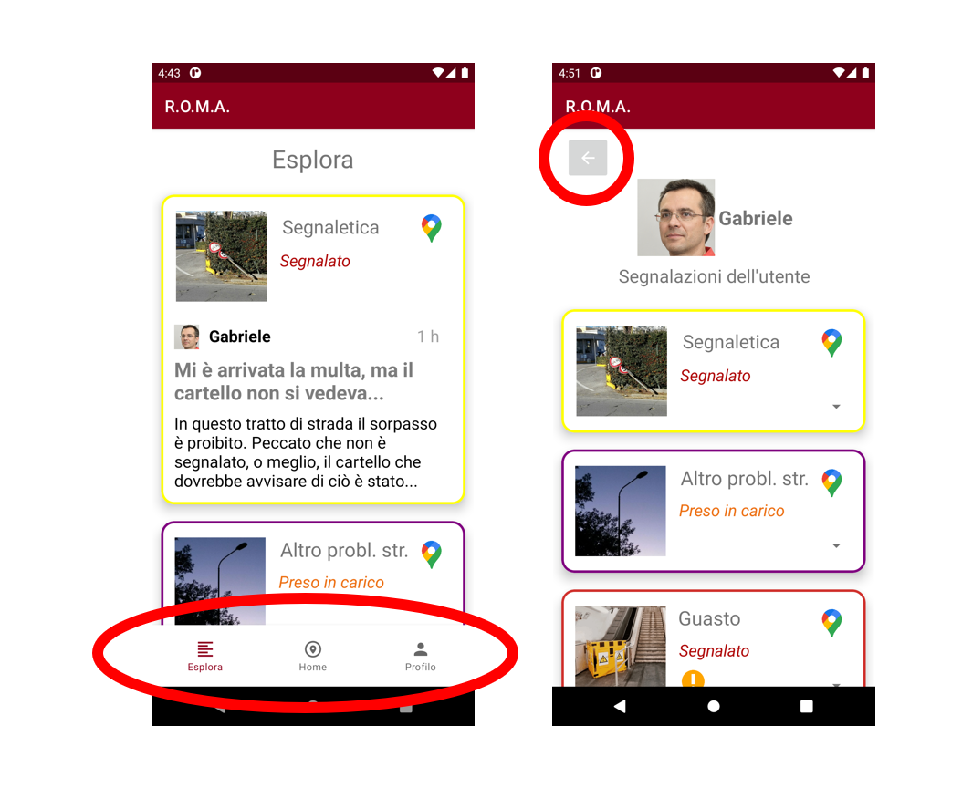
We allow the user to move from a section to another of the app leaving the unwanted state without any problem.
UI elements that allow to go back a step

Slide 32
User-based evaluation technique – think aloud
Third prototype
The think aloud is a kind of evaluation based on some simple rules.
In particular, the user is asked to perform a determined number of task and he has to voice his thoughts about what he is doing and what he thinks is happening.
Generally, in this phase, evaluators records all the user’s actions and problem.
After the think aloud evaluation, we have decided to modify our application and to add some features. In the following slides we will show the changes.

Slide 33
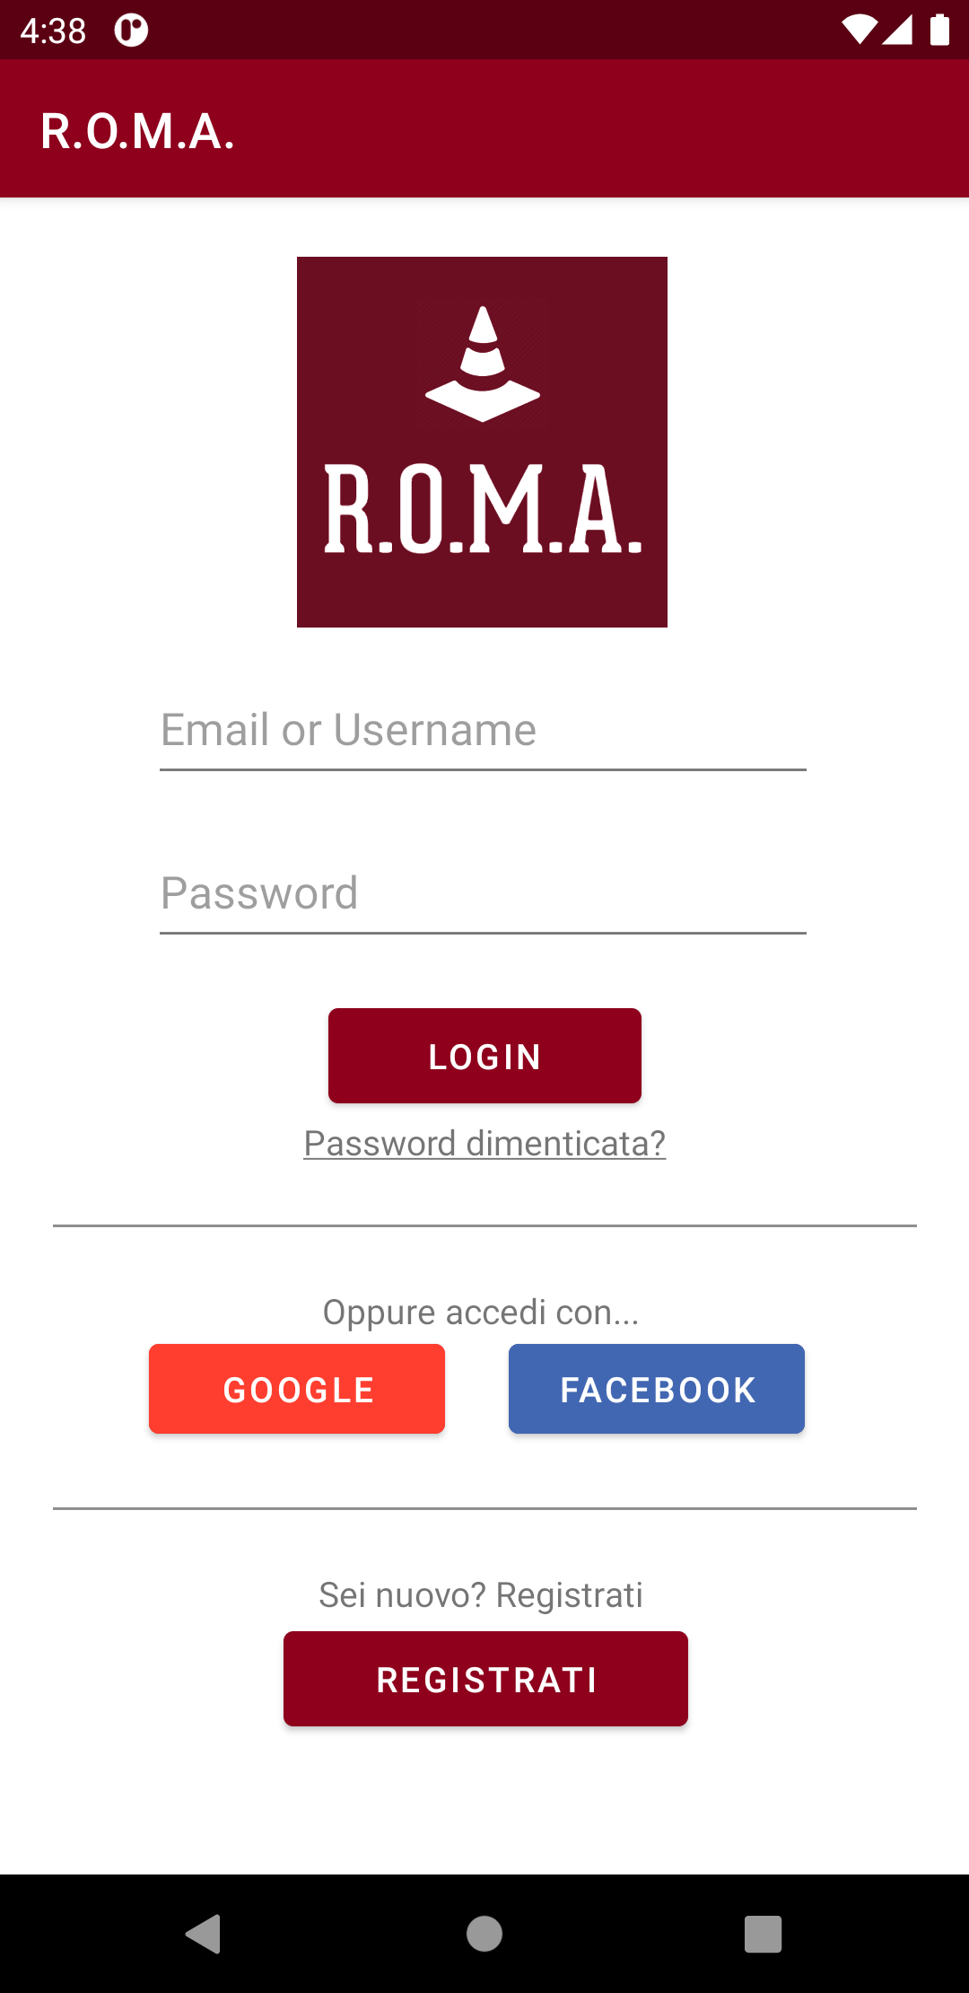
We add a login feature using external social media accounts
Login page: before
Login page: after

Slide 34
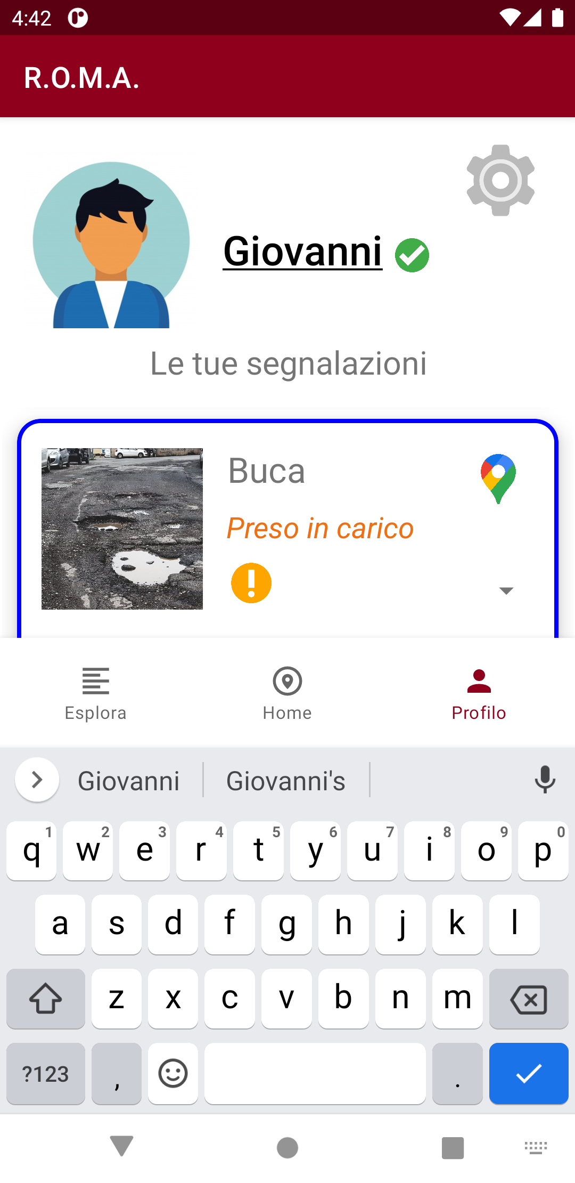
We add the possibility to change the username

Slide 35
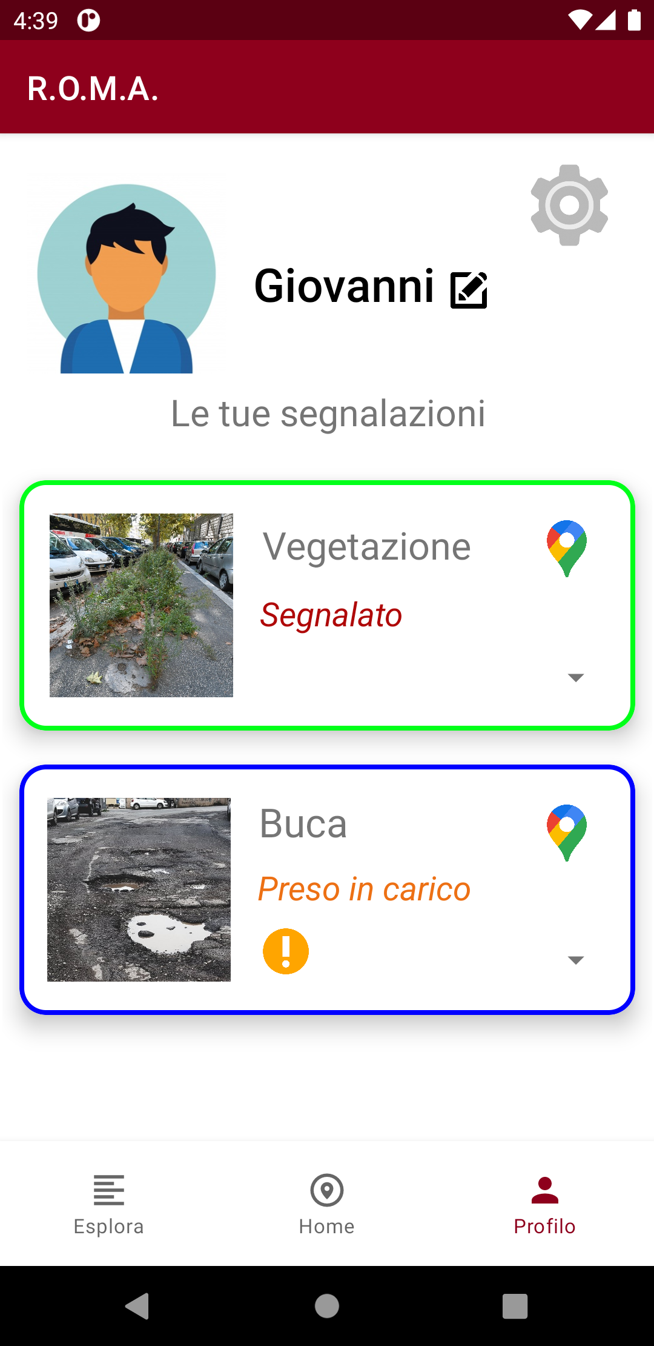
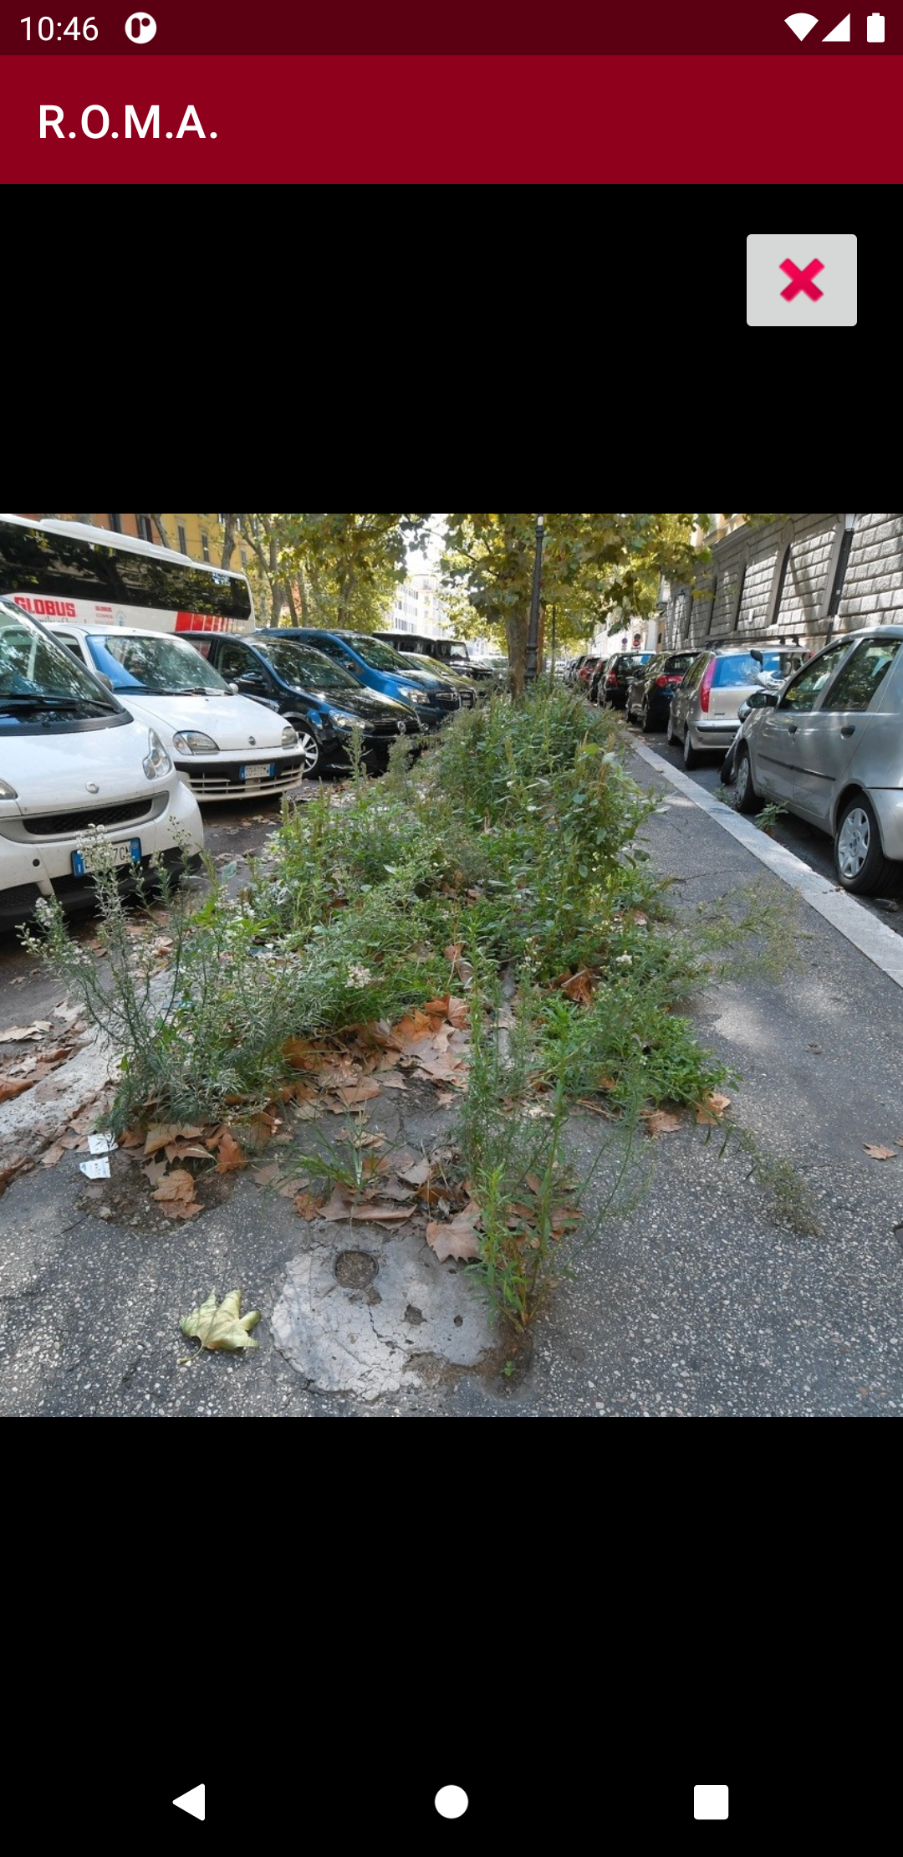
We add the possibility to view images in full size

Slide 36
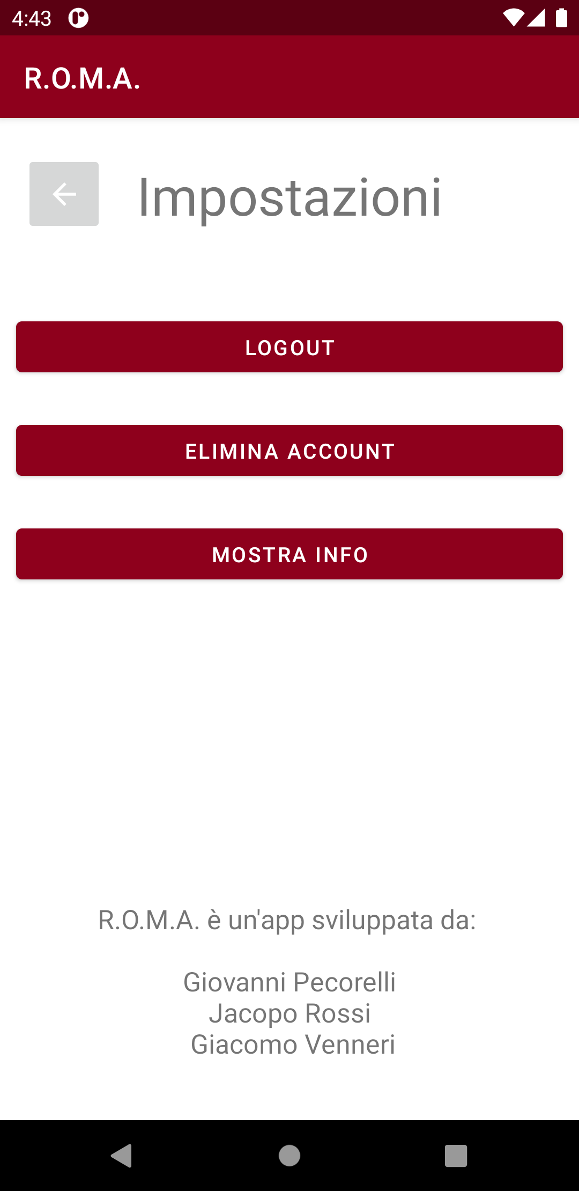
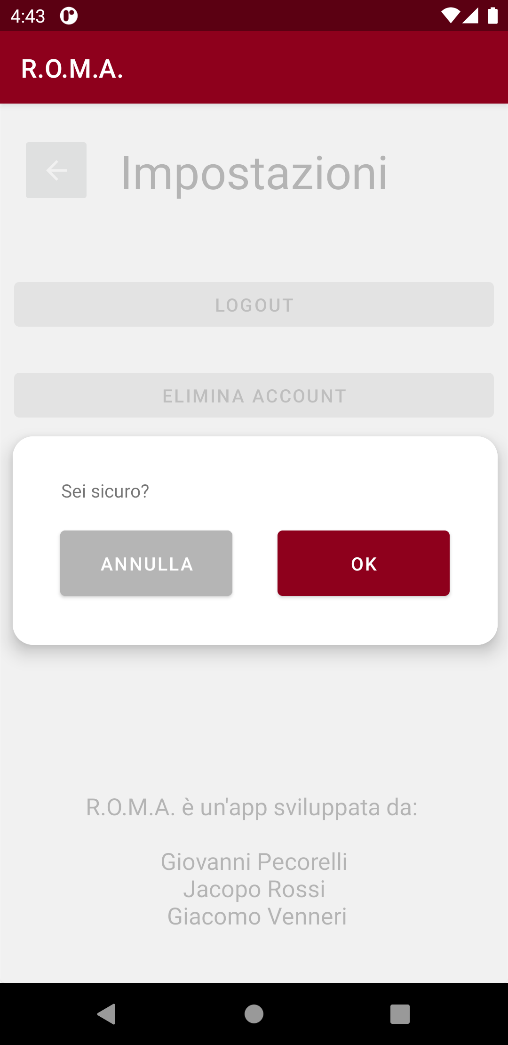
We add a Settings page containing buttons to logout, delete your account and read again the Info page

Slide 37
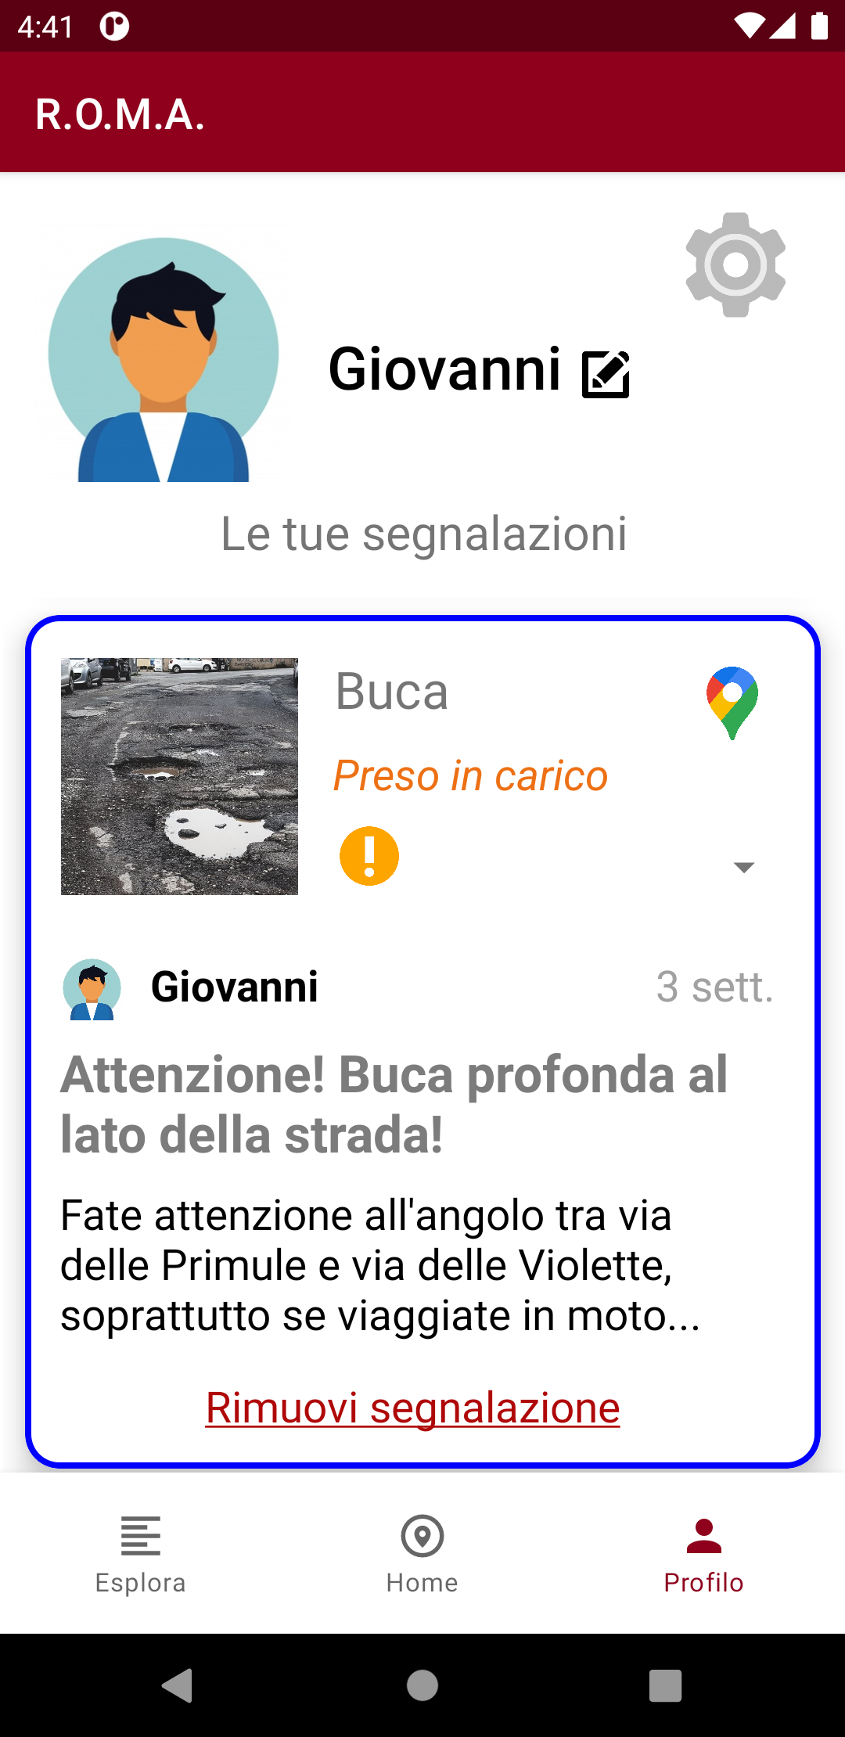
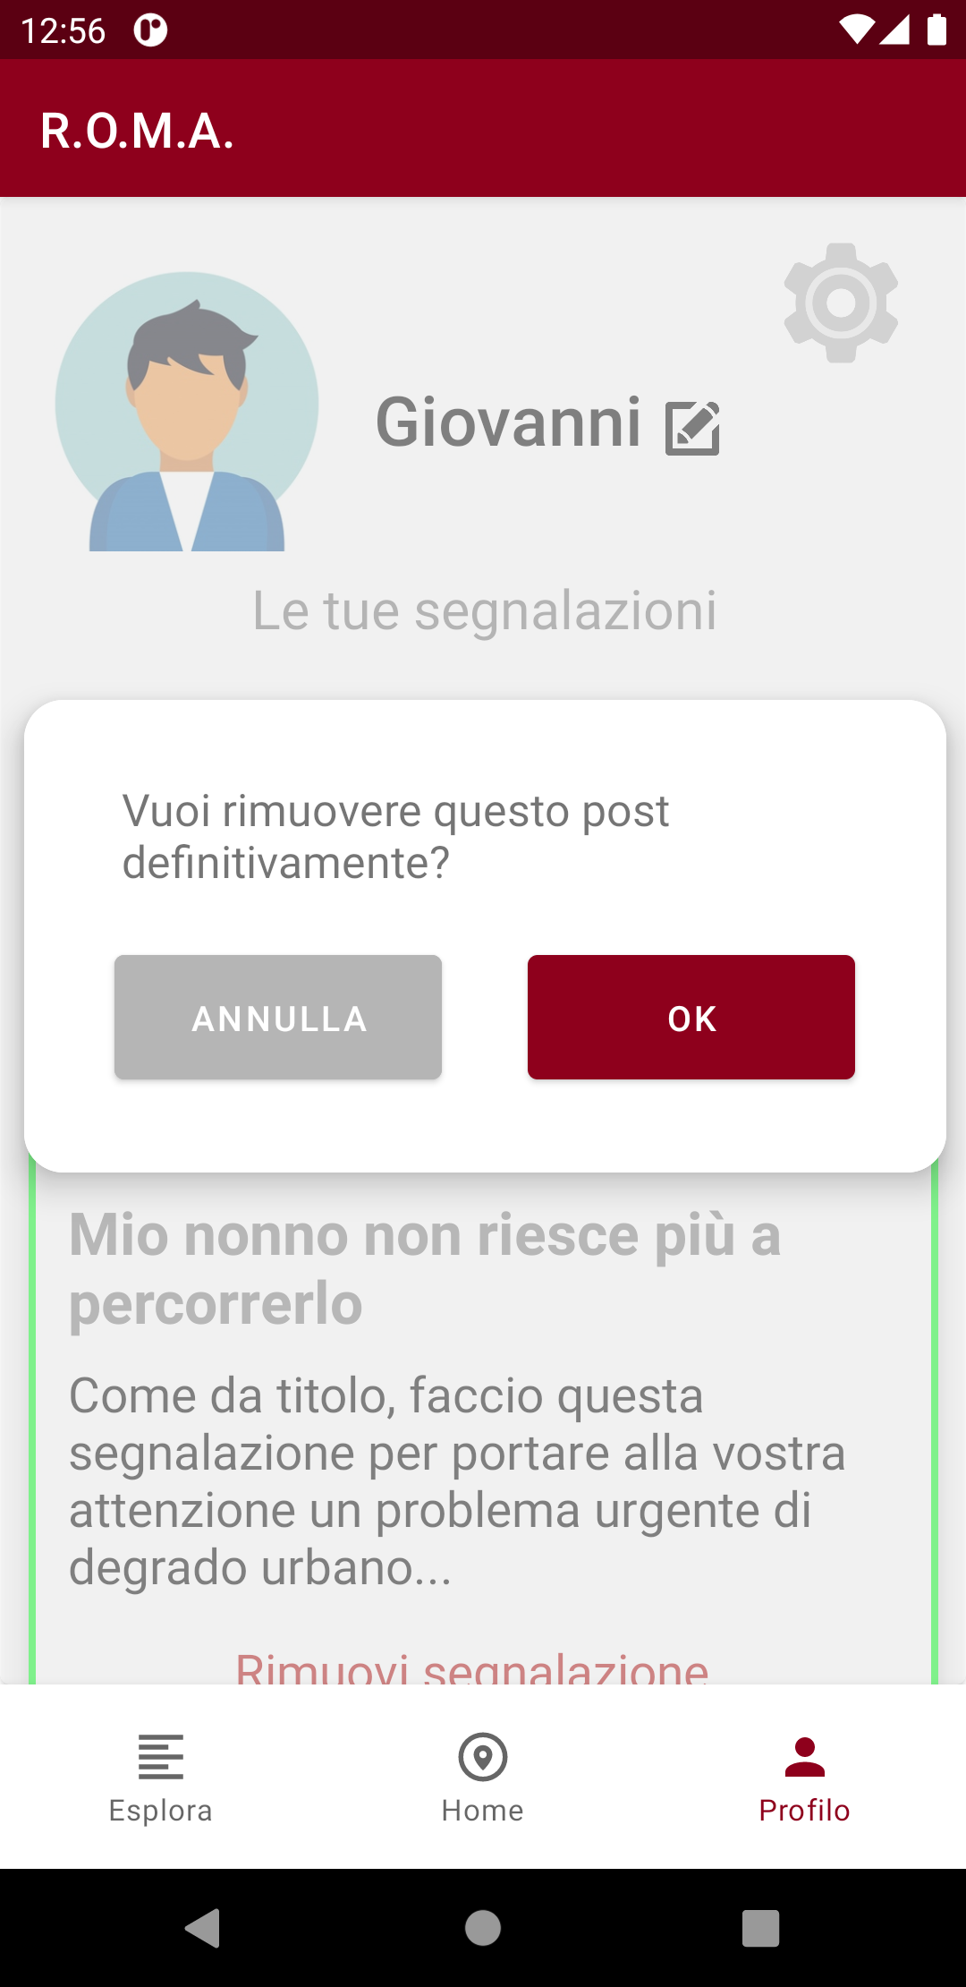
We add the possibility to delete a report, removing the relative card from the app, and its relative marker from the map

Slide 38
User-based evaluation technique – controlled experiment
A controlled experiment is when an observer tests a hypothesis by looking for changes brought on by alterations to a variable.
In our case the hypothesis was if the first prototype interface of the Homepage is better that the alternative second interface.

Slide 39
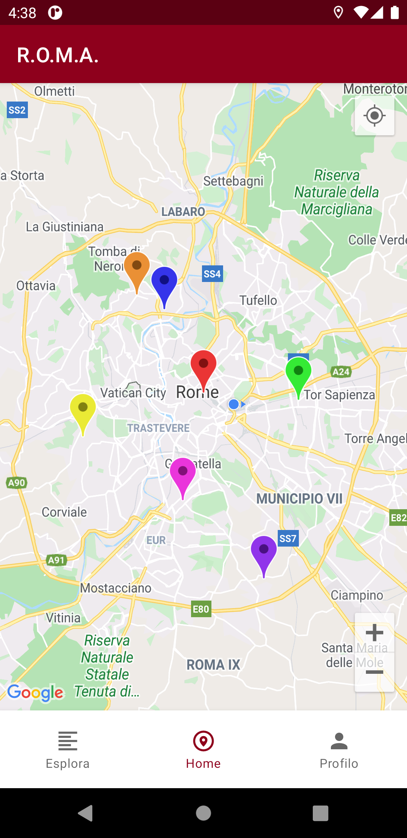
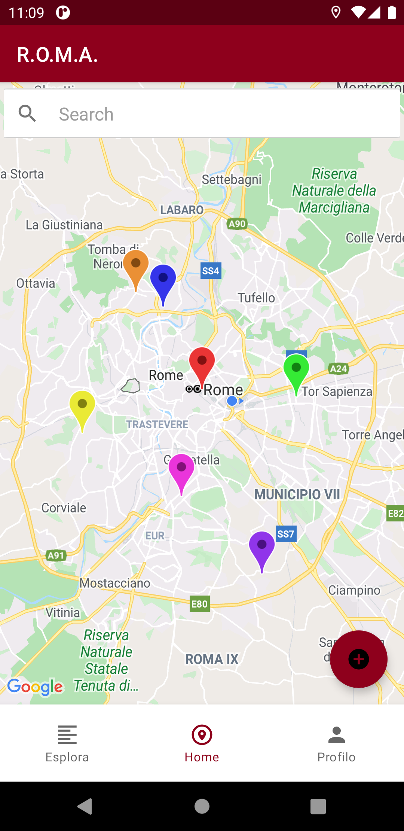
Homepage: Interface 1
Homepage: Interface 2

Slide 40
ANOVA
• Problem: “Having implemented two distinct interface styles which differ in the way
users perform the same task, which of them is easier to use?”
• Who? 12 people (in a range of age between 18-60 years old according to user profiles)
• Variables:
– independent: the two interfaces
– dependent: the time in seconds to execute the task
• Hypothesis:
– null: there are no differences between the two interfaces
– our: users will complete the task in less time using Interface 1 rather than Interface 2
• Experiment:
– task: "Add a new report"
– assumptions: User is already logged in, on the homepage, and has to create a report
given its attributes (title, description, image...)

Slide 41
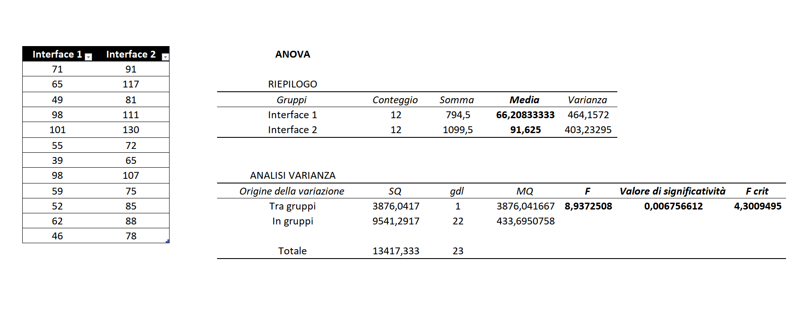
ANOVA results
ANOVA experiment results measured in seconds

Slide 42
LIVE DEMO!

